Slide 1

Saint Joseph’s Church
Saint John the Baptist

Slide 2
Just
Another Meeting…
Presented by The Benedictine Communities of St. Joseph and St. John the Baptist

Slide 3
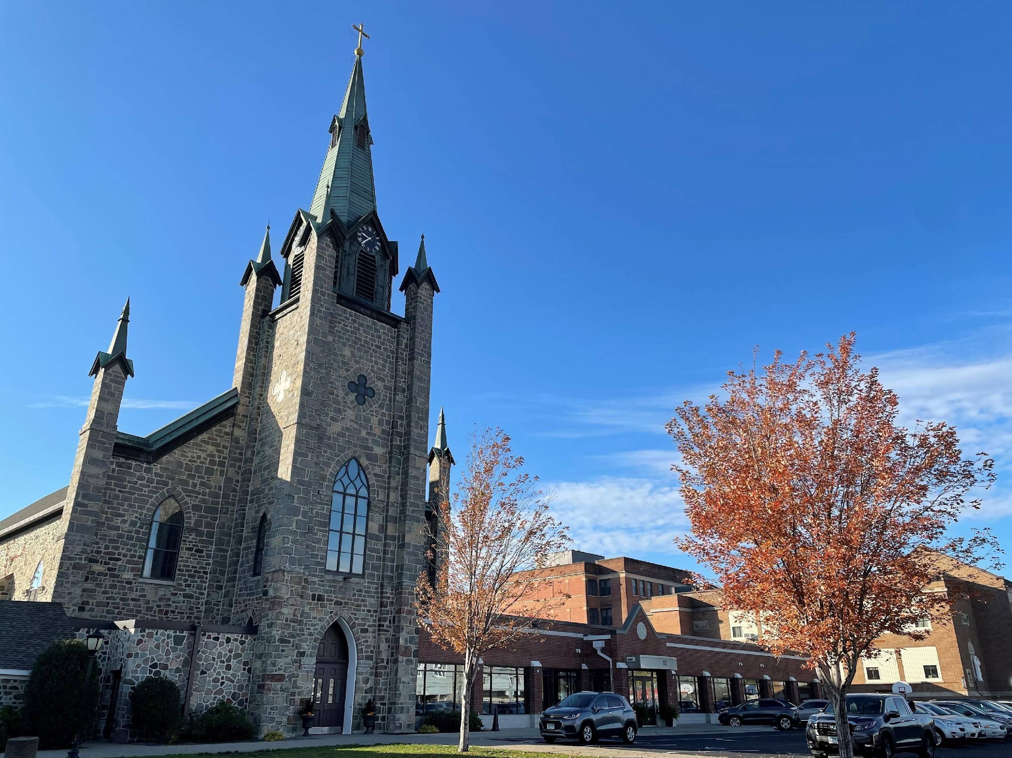

Slide 4
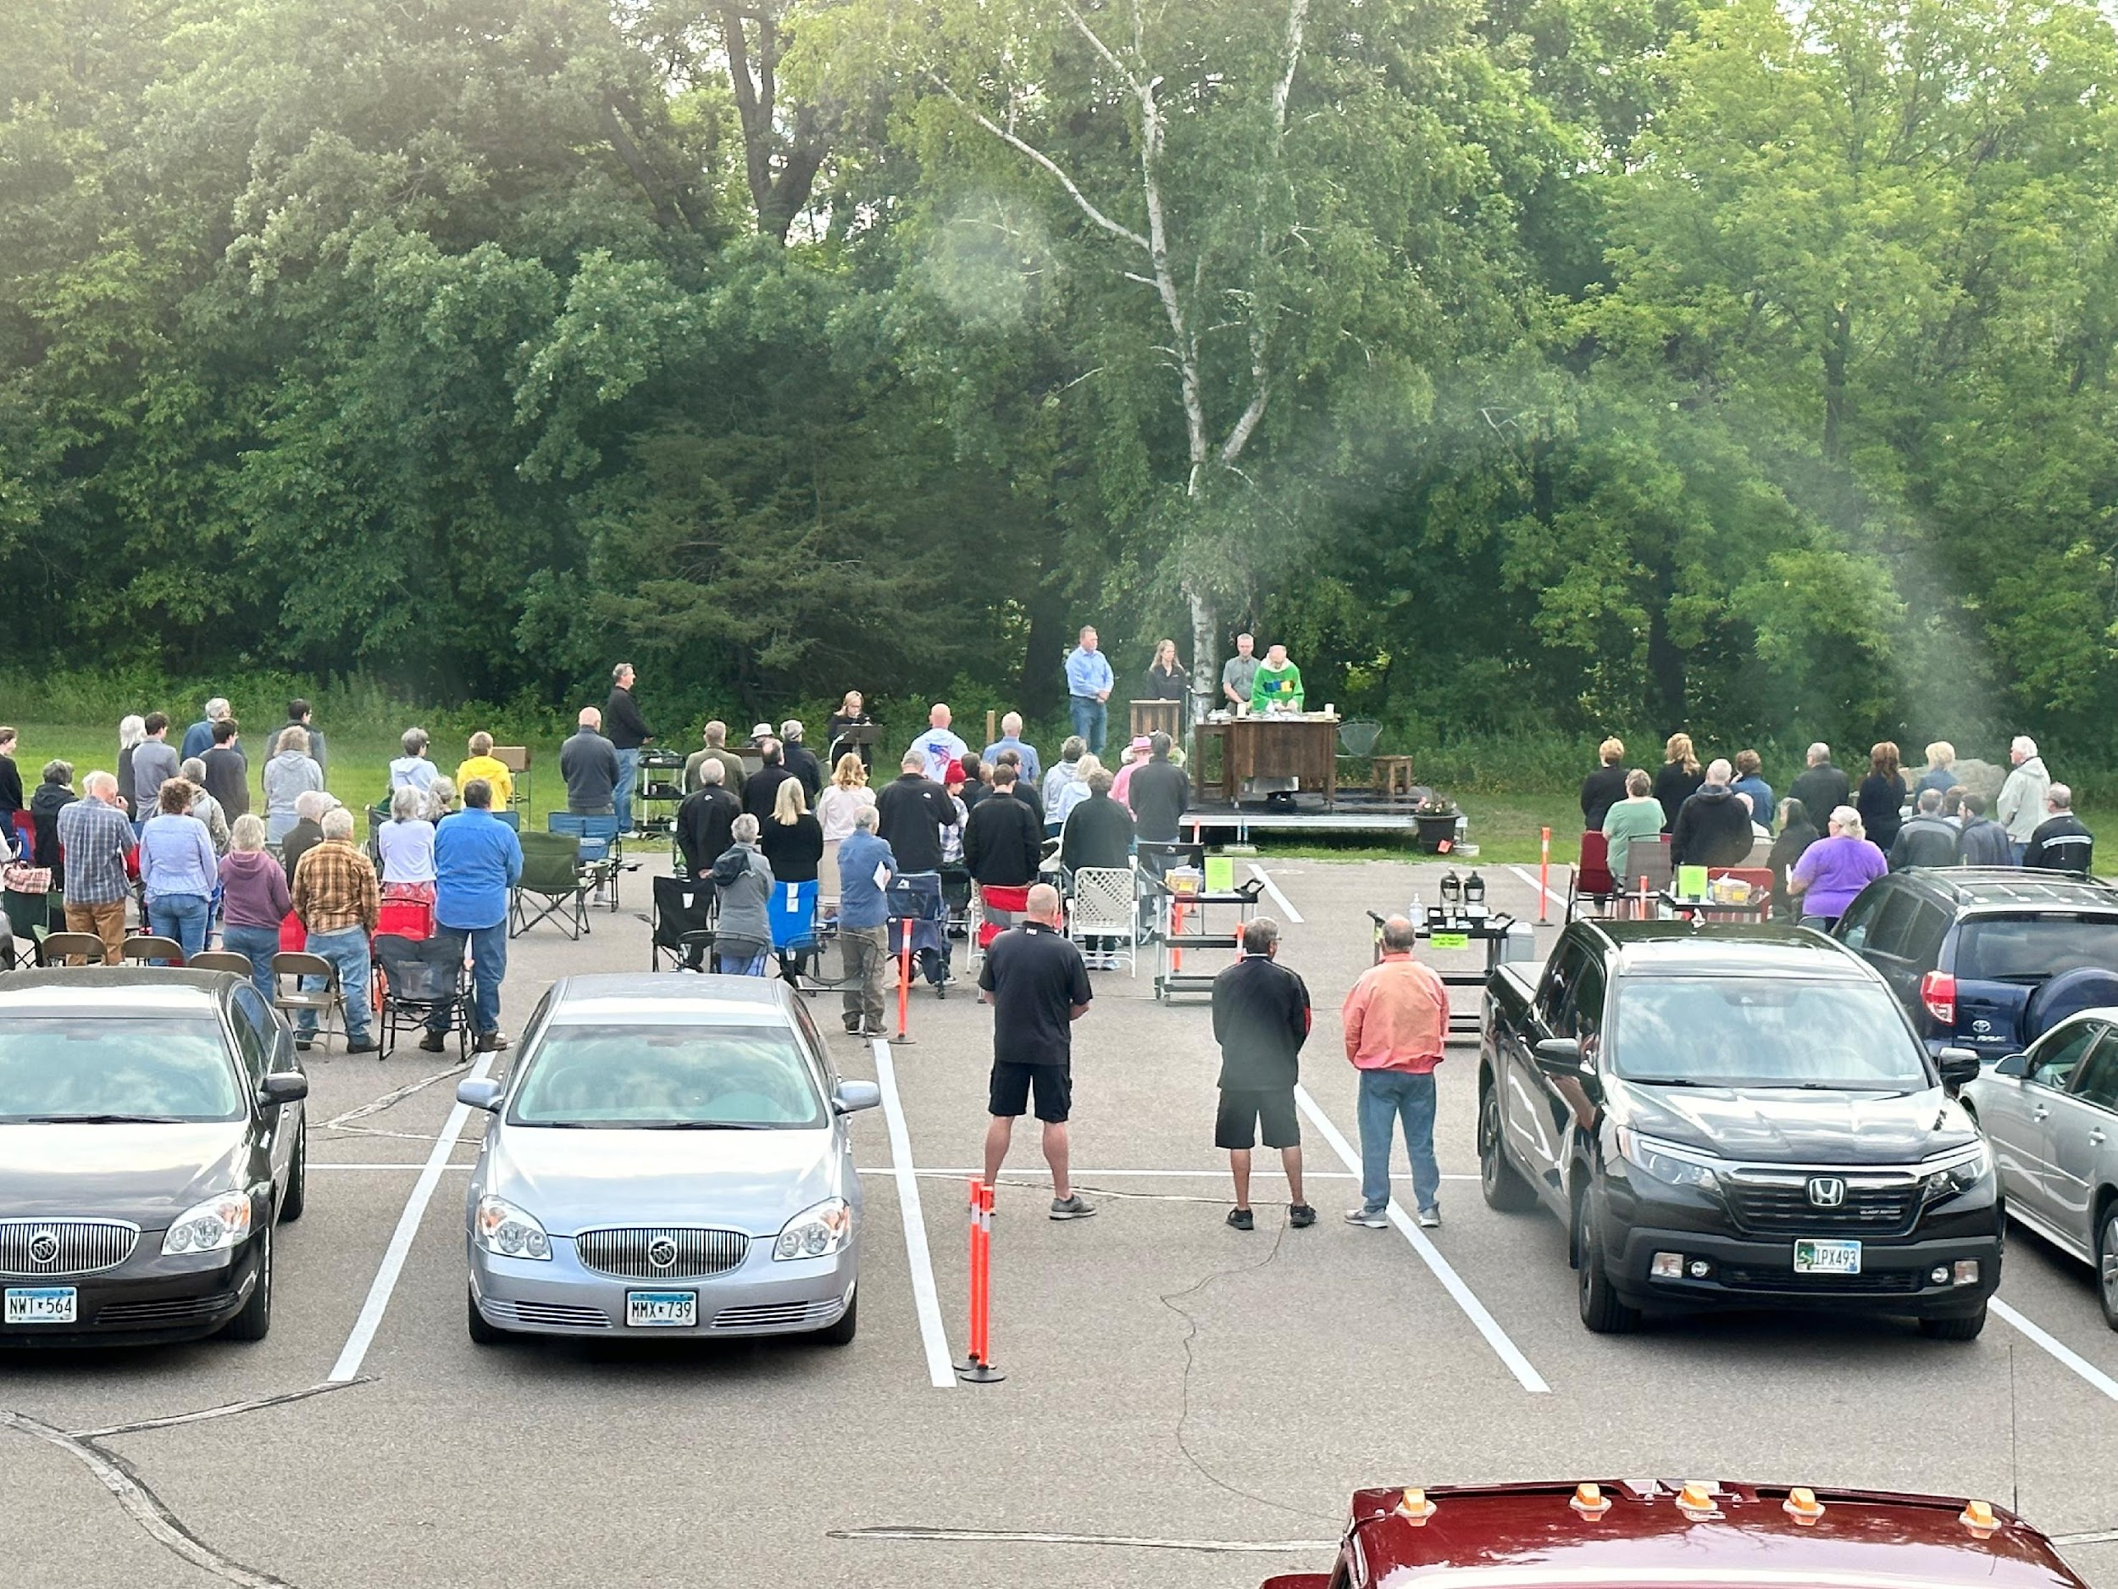

Slide 5
“Take courage, it is I.
Do not be afraid.”
Matthew 14:27

Slide 6
"The Lord is near to all who call upon Him,
to all who call upon him in truth."
Psalms 145:18

Slide 7
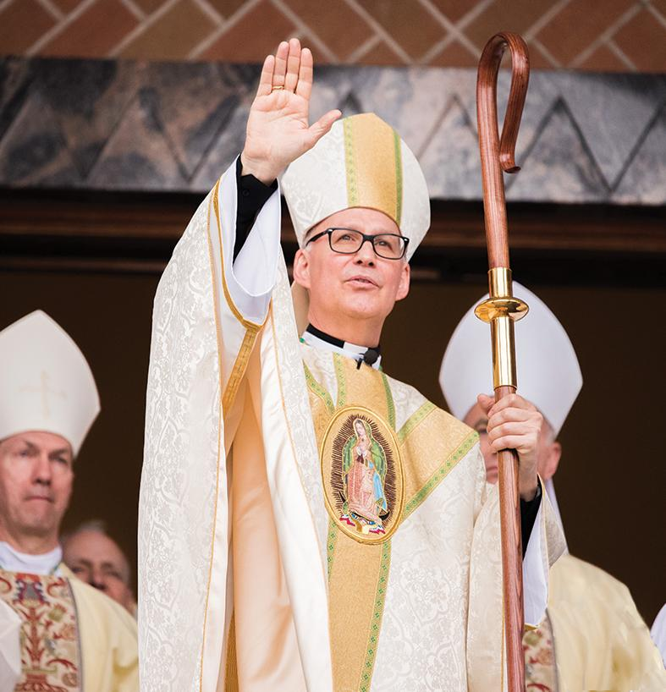

Slide 8
“You are many parts,
but all one body...
You are the Body of Christ,
each one of you!"
1 Corinthians 12:12-27

Slide 9
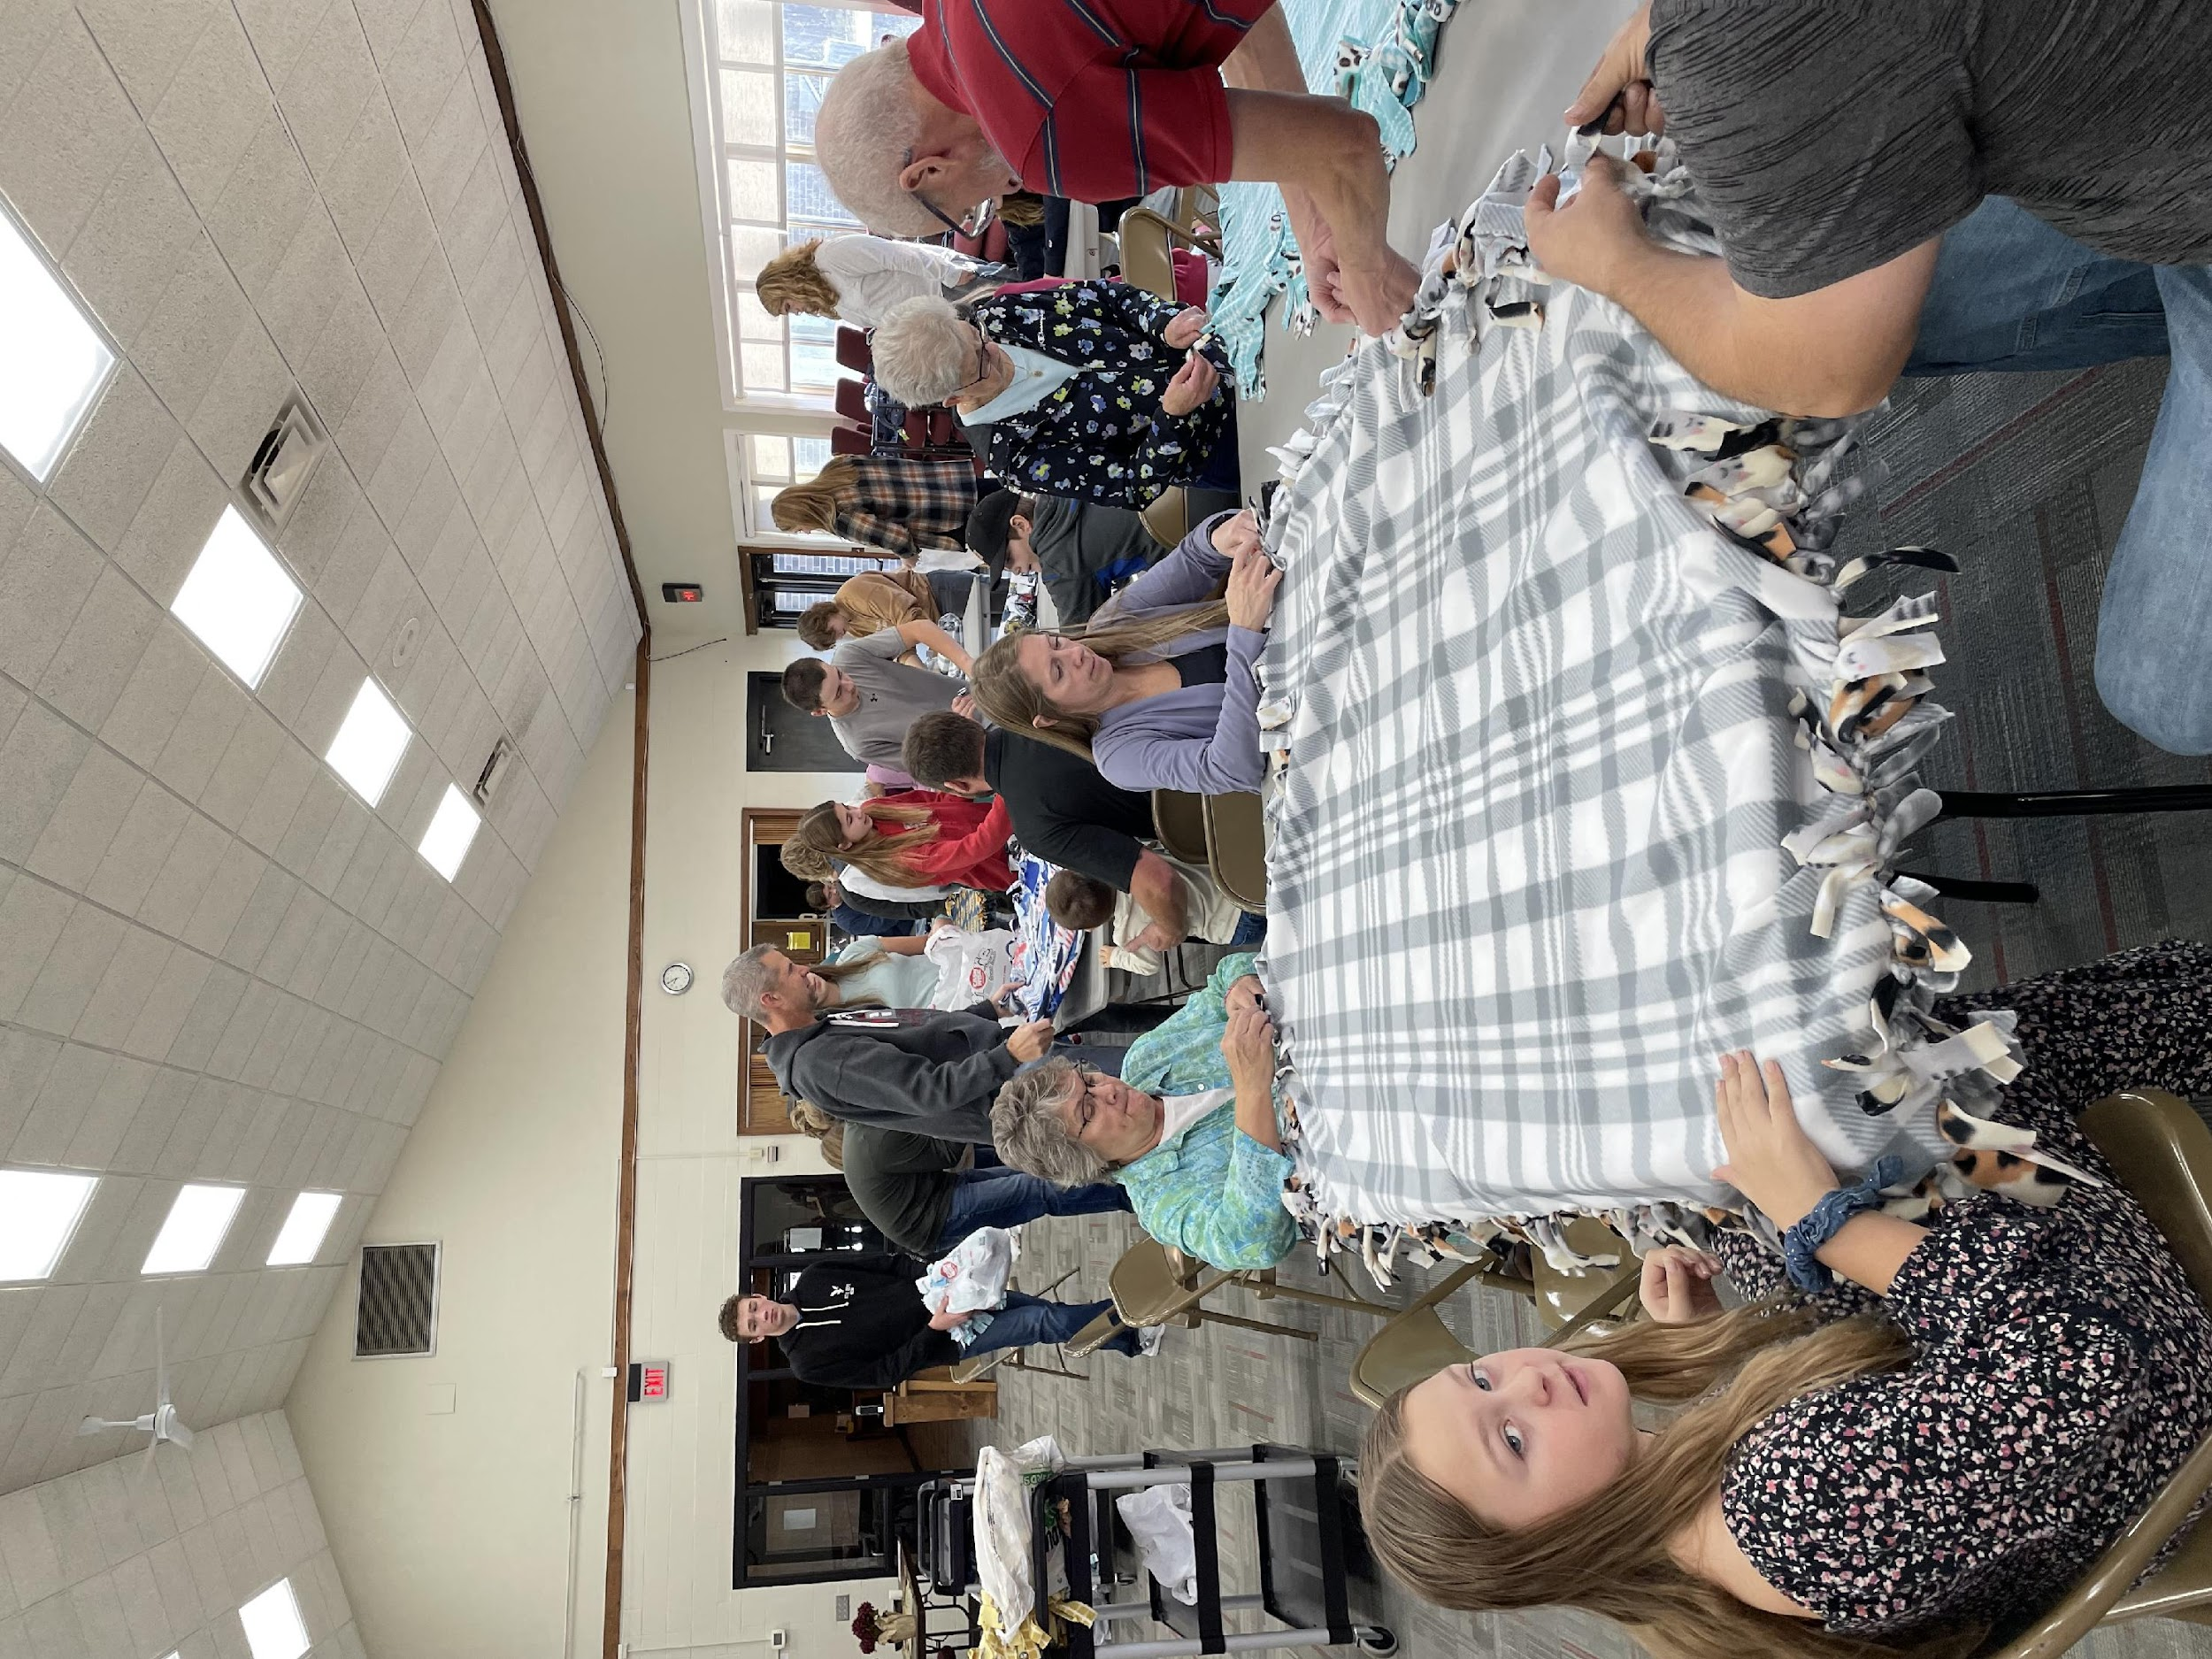

Slide 10
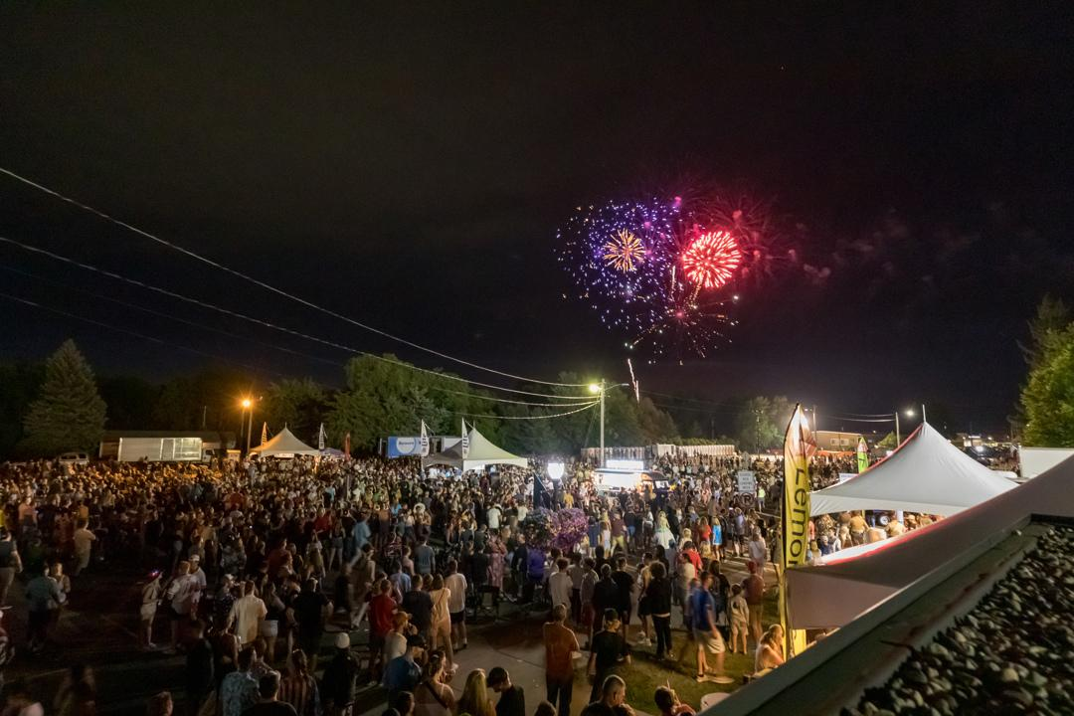

Slide 11
“Pay careful attention to yourselves,
and to all the flock,
in which the Holy Spirit made you overseers,
to care for the Church of God."
Acts 20:28

Slide 12
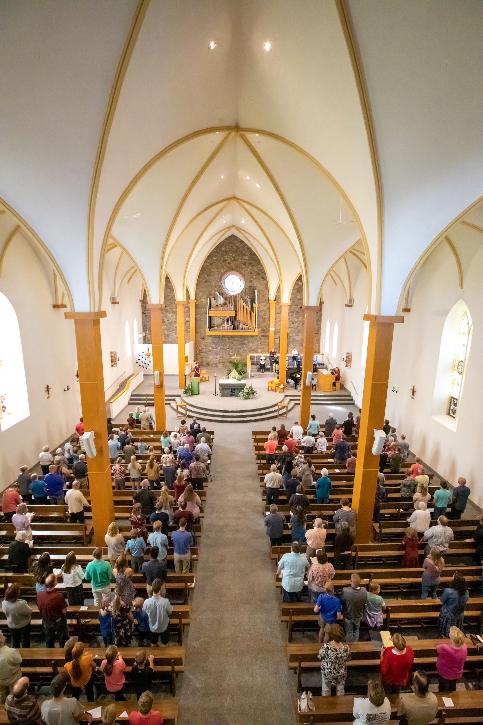

Slide 13
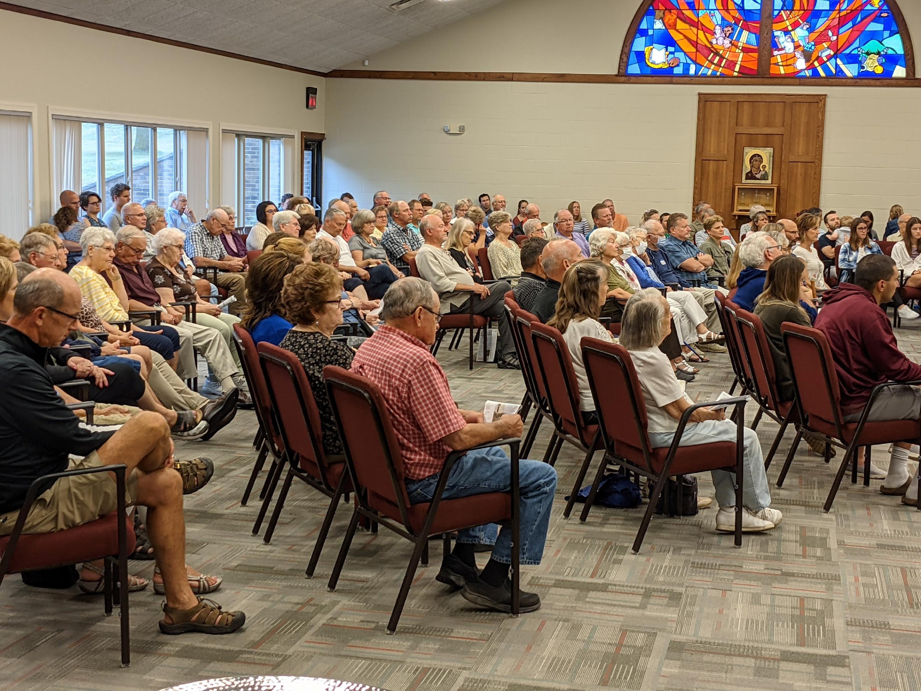

Slide 14
“Love the Lord your God with all your heart,
and with all your soul
and with all your mind
and with all your strength.”
Mark 12:30

Slide 15
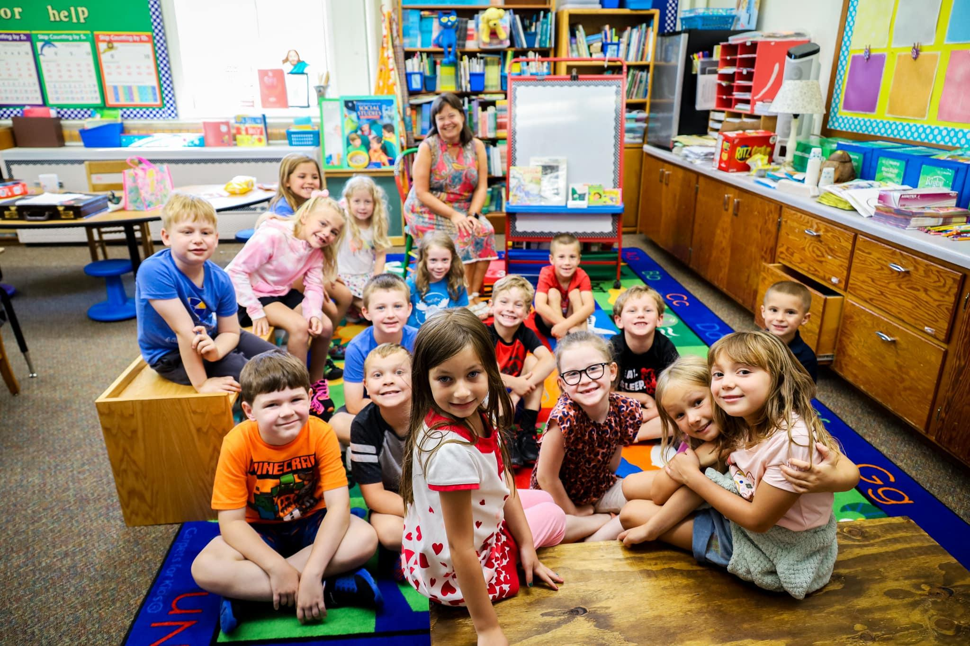

Slide 16
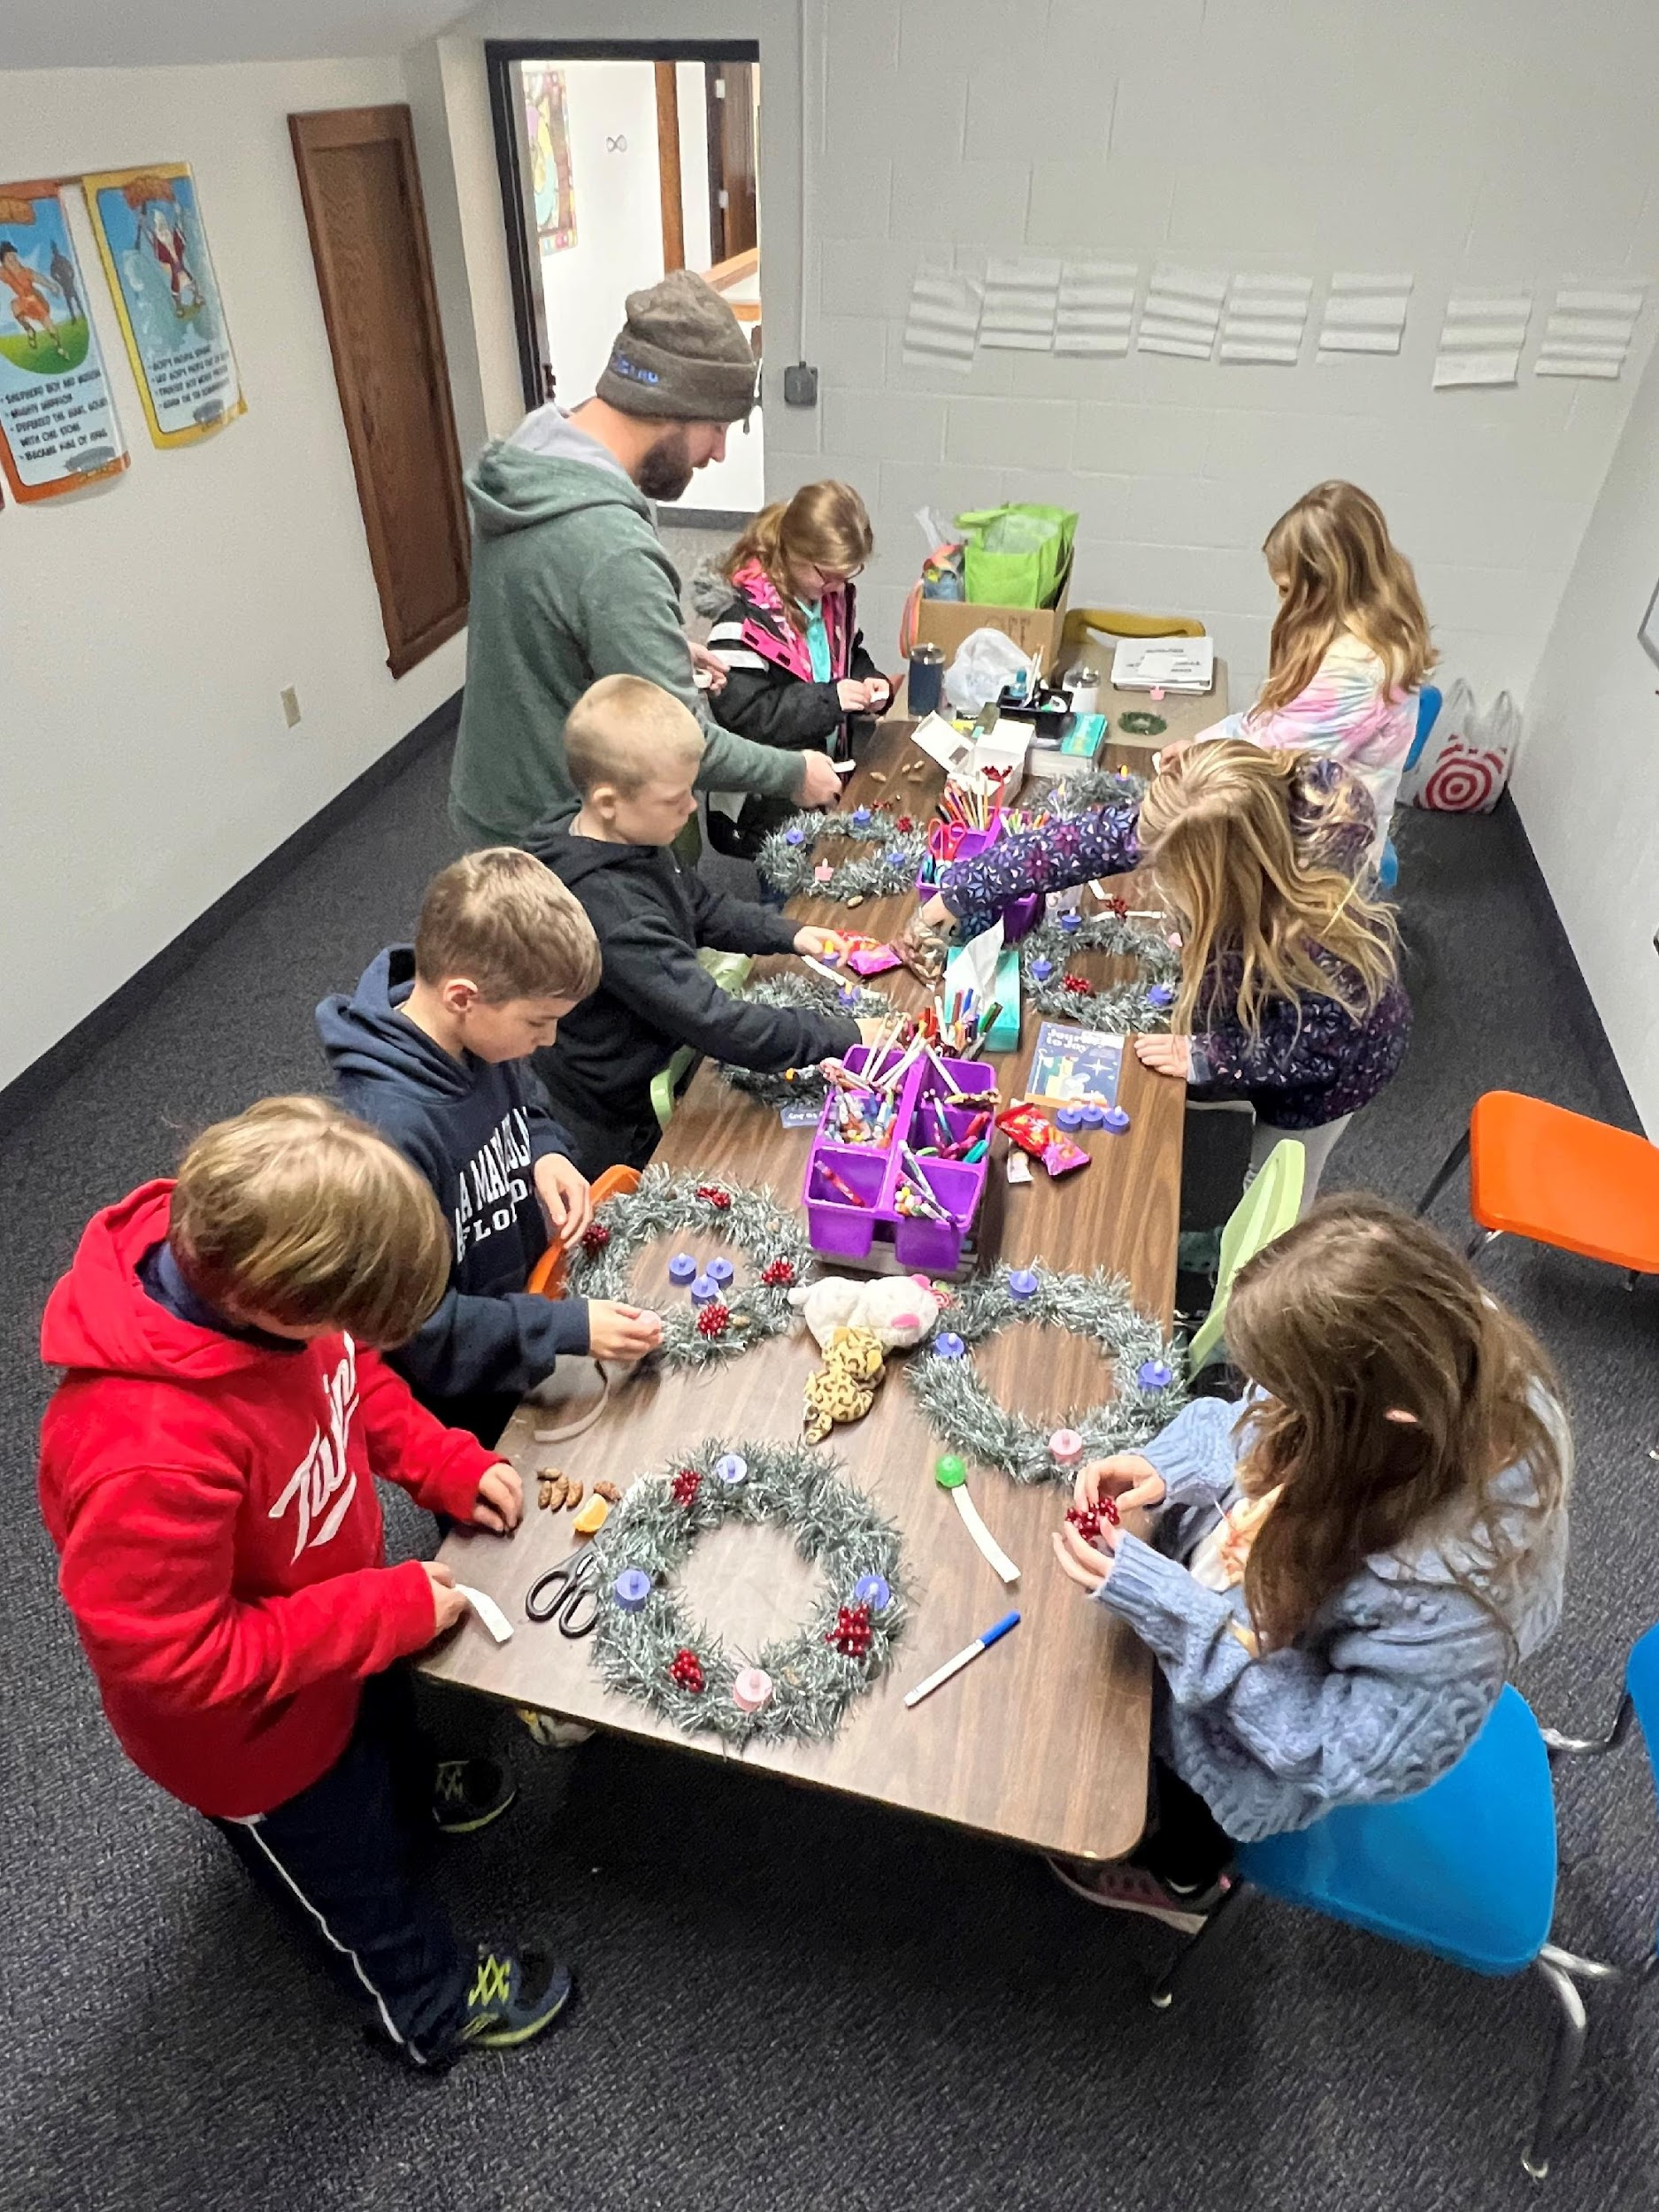

Slide 17
“Let the little children come to Me,
and do not hinder them,
for the kingdom of God
belongs to them.”
Matthew 19:14

Slide 18
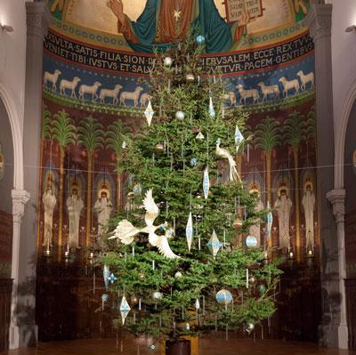

Slide 19
NOT
Just another meeting…
An Extraordinary meeting!
Hallelujah!

