Slide 1


Slide 2
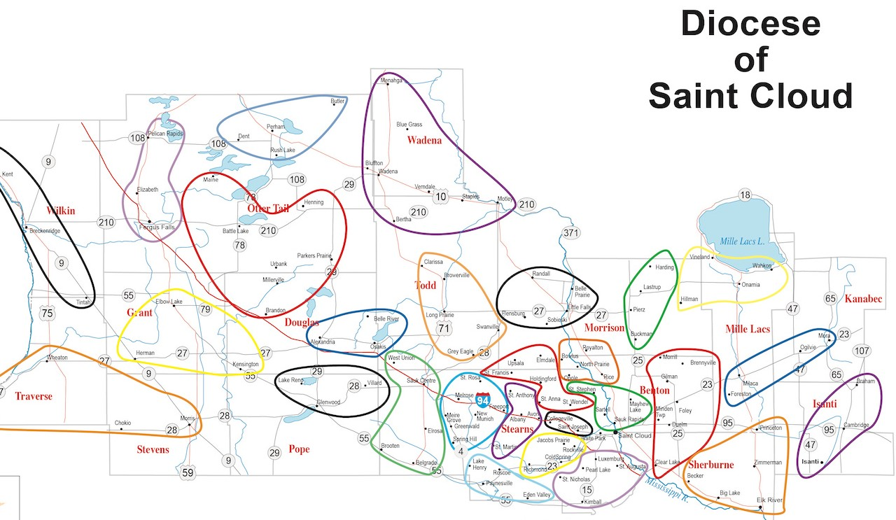
Area Catholic Communities Map
Harvest of Hope
Notes:
Karen P. Switch slides as Karen starts to talk about each parish and location
Shared school district (for most part) - builds upon existing community formed in school relationships
Distance from furthest apart parishes is about 30 minutes - not far to drive for priests or parishioners
Community sizes vary - Populations St. Anthony - 90, Avon 1,700, Albany 2,800, St. Martin 300
Parishes draw members from the rural areas - St. Anthony 133 families, Avon 444 families, Albany 556 families, St. Martin 293 families
Albany area common sports schedules, town center with grocery store, library, etc.
Proximity to St. John’s Abbey/School of Theology

Slide 3
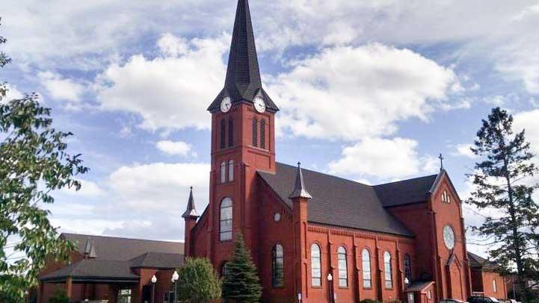
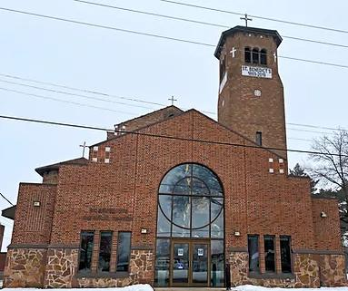
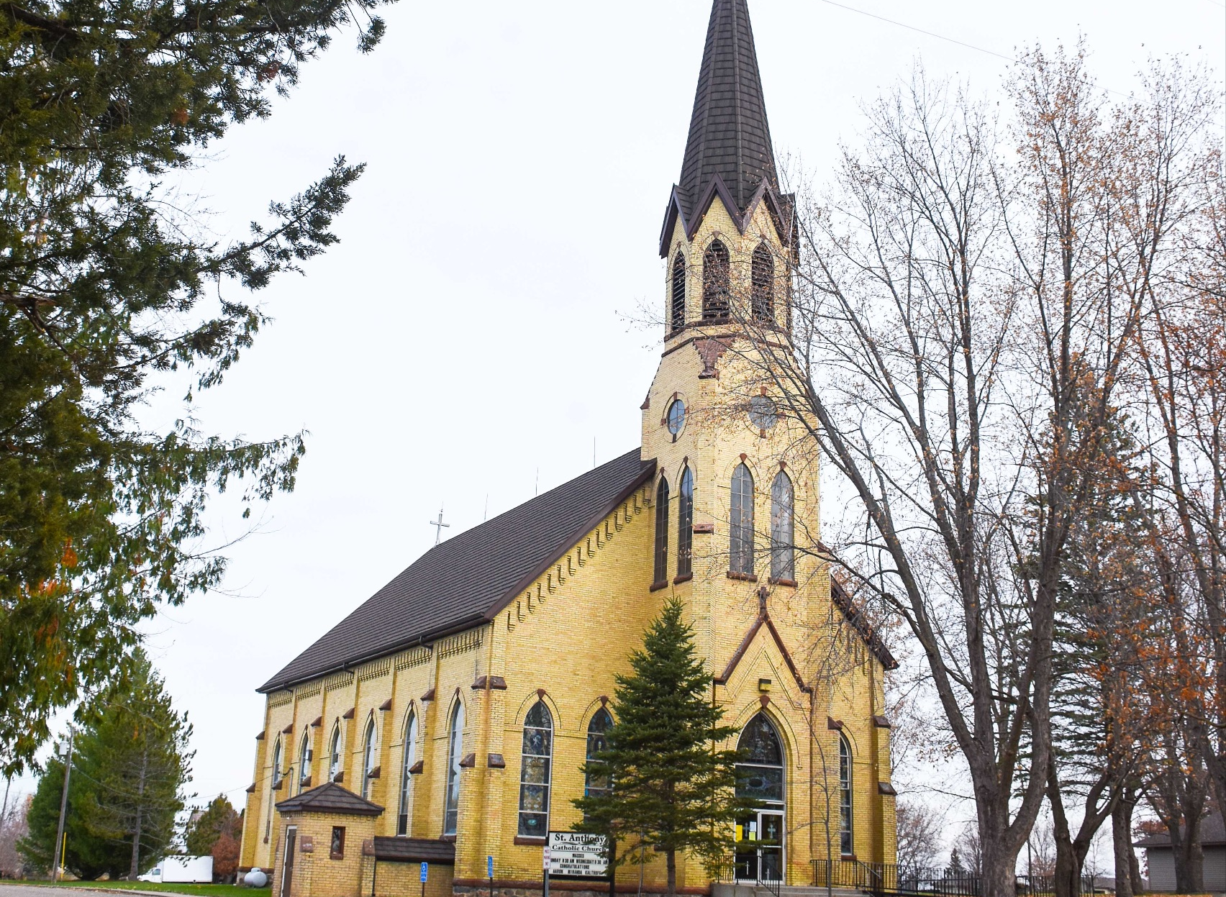
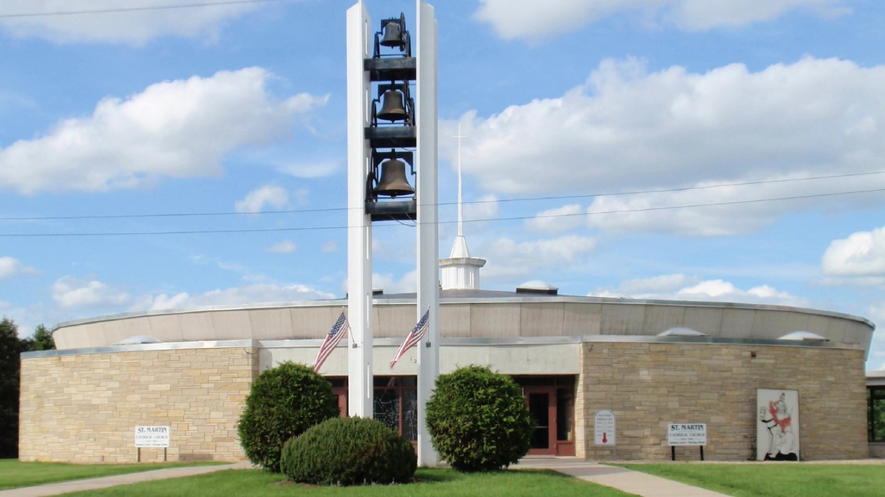
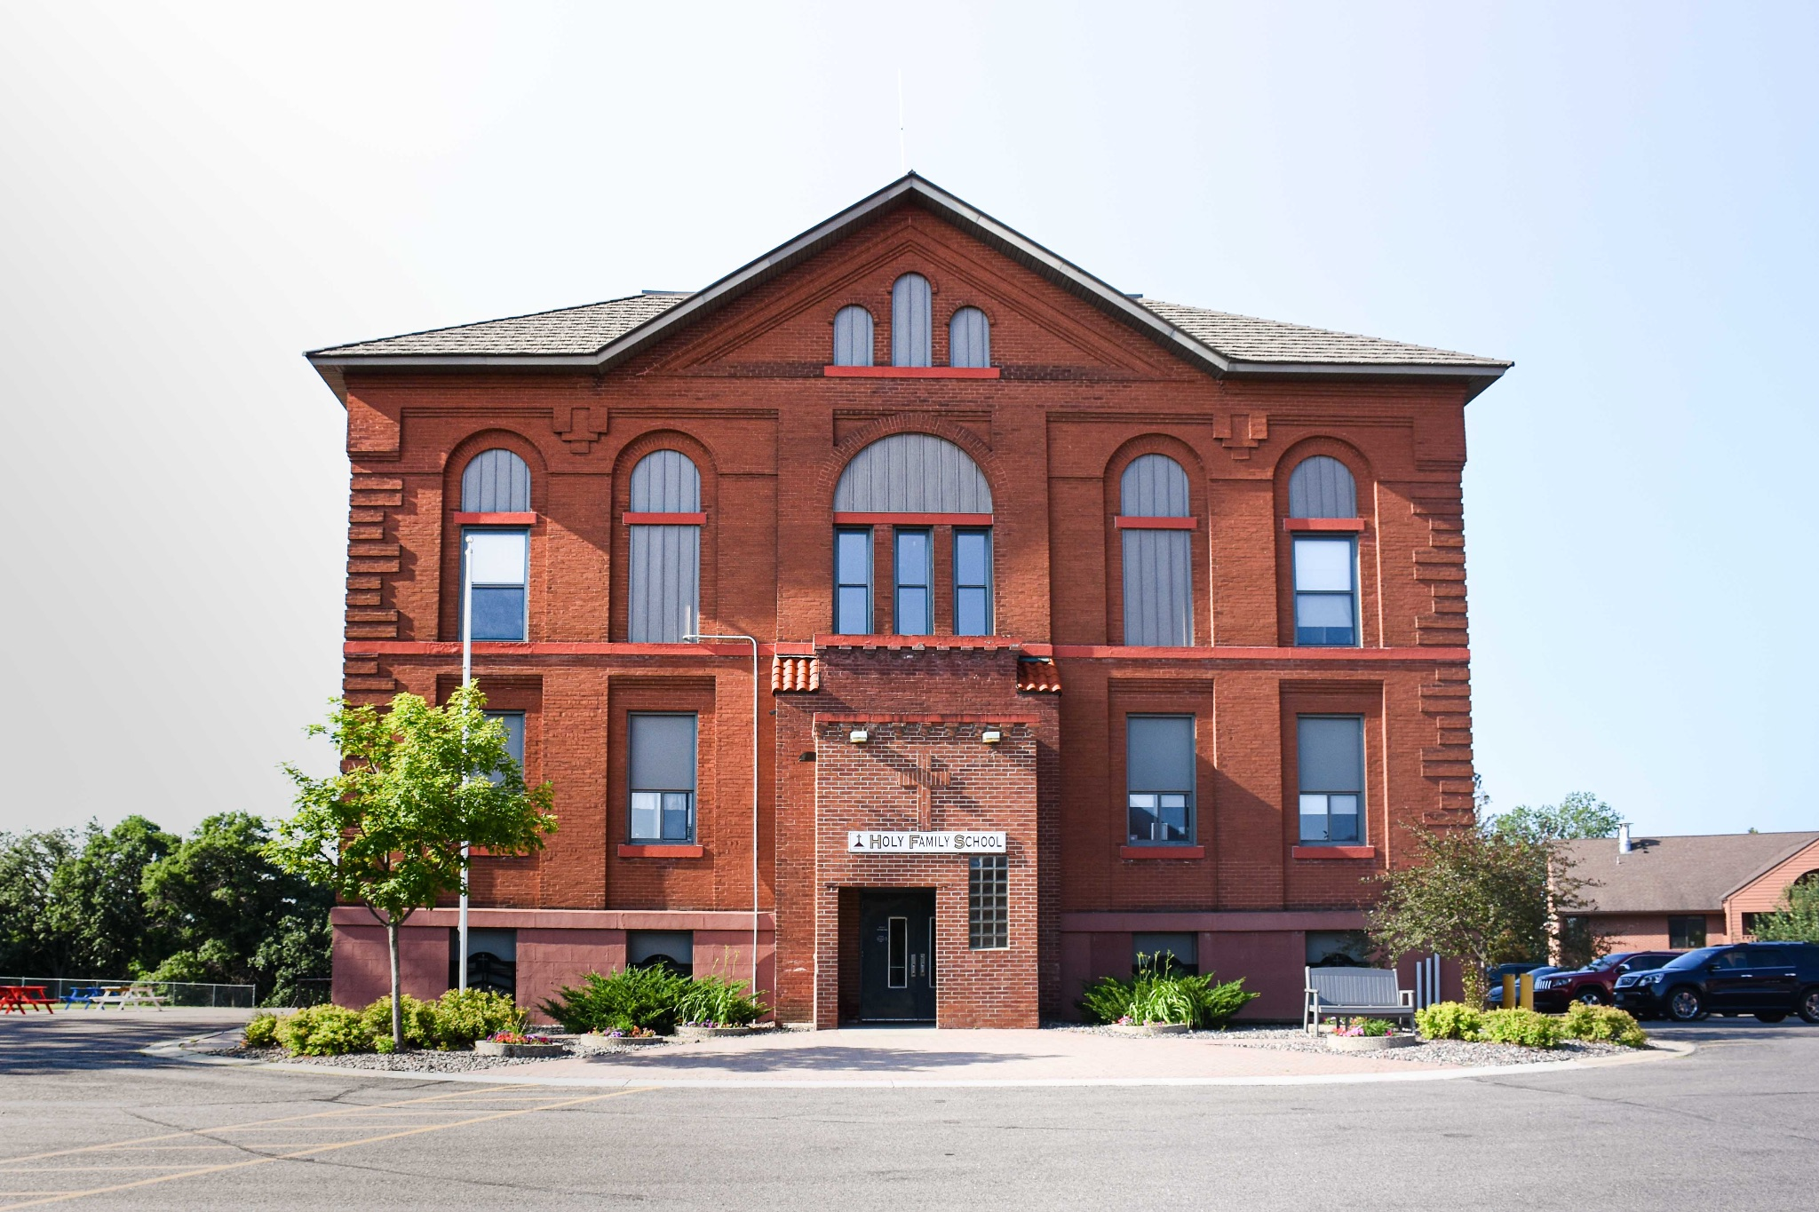
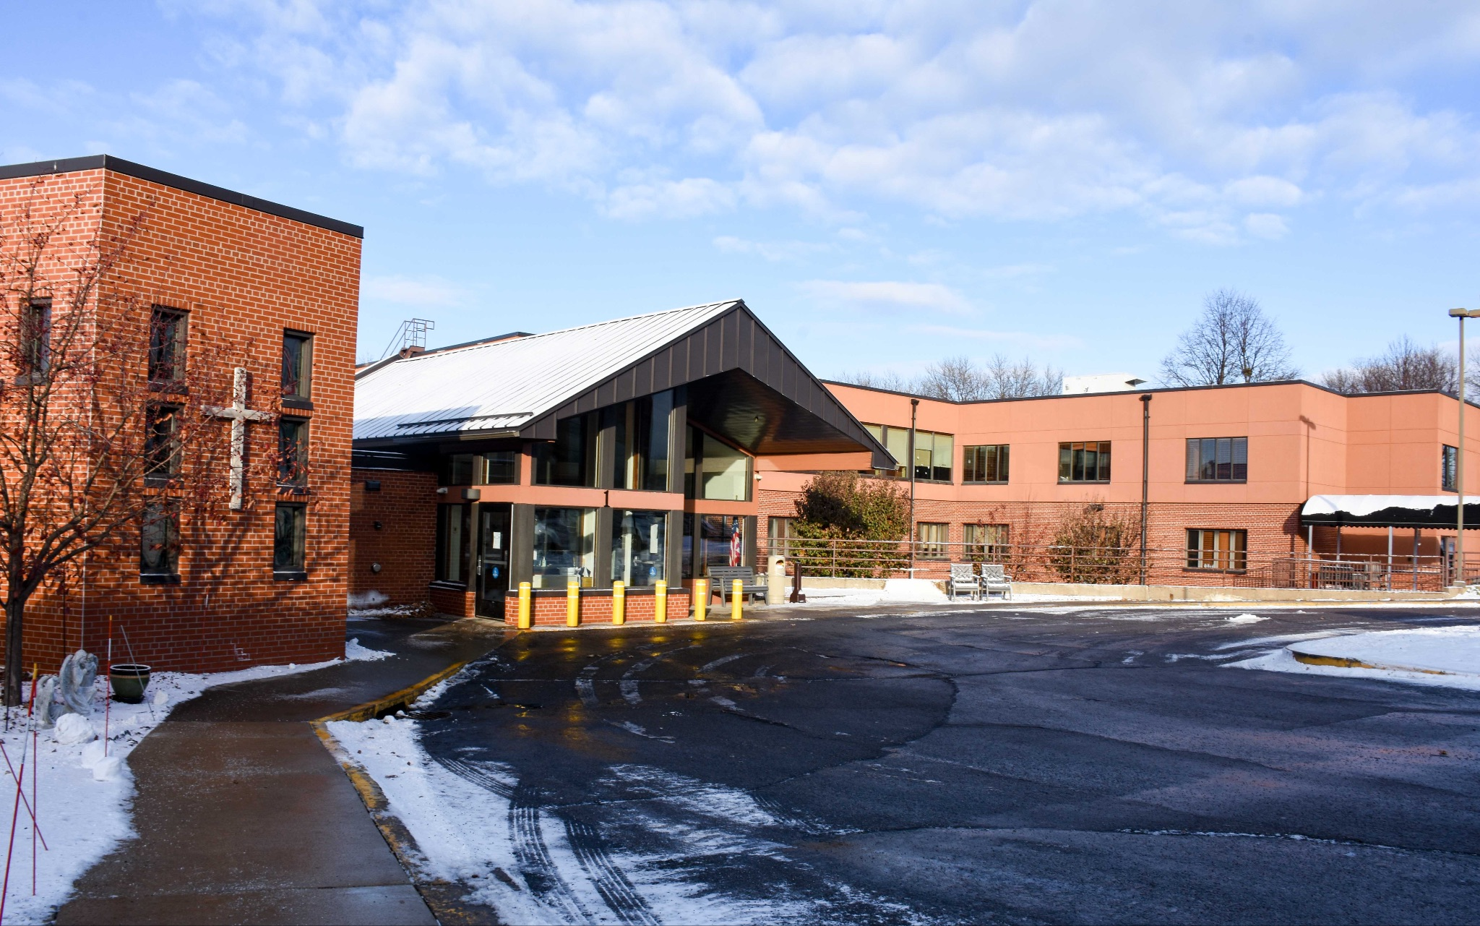
Harvest of Hope Catholic Community
Four cities: Albany, Avon, St. Anthony & St. Martin
Seven entities: Seven Dolors Parish, Albany; St. Benedict Parish, Avon;
St. Anthony Parish, St. Anthony; St. Martin Parish, St. Martin; St. Catherine Oratory, Farming; Holy Family School, Albany; Mother of Mercy Senior Living, Albany
Notes:
Barb will start with Oratory, Mark will introduce MOM he will end with saying the other entity Holy family will be talked about shortly
Parishes of Saint Anthony, Saint Benedict, Saint Martin, Seven Dolors. Oratory of Saint Catherine, Mother of Mercy Senior Living, Holy Family School
5,000 people, 1700 families.
____ students at HFS and ____ residents at MOM

Slide 4
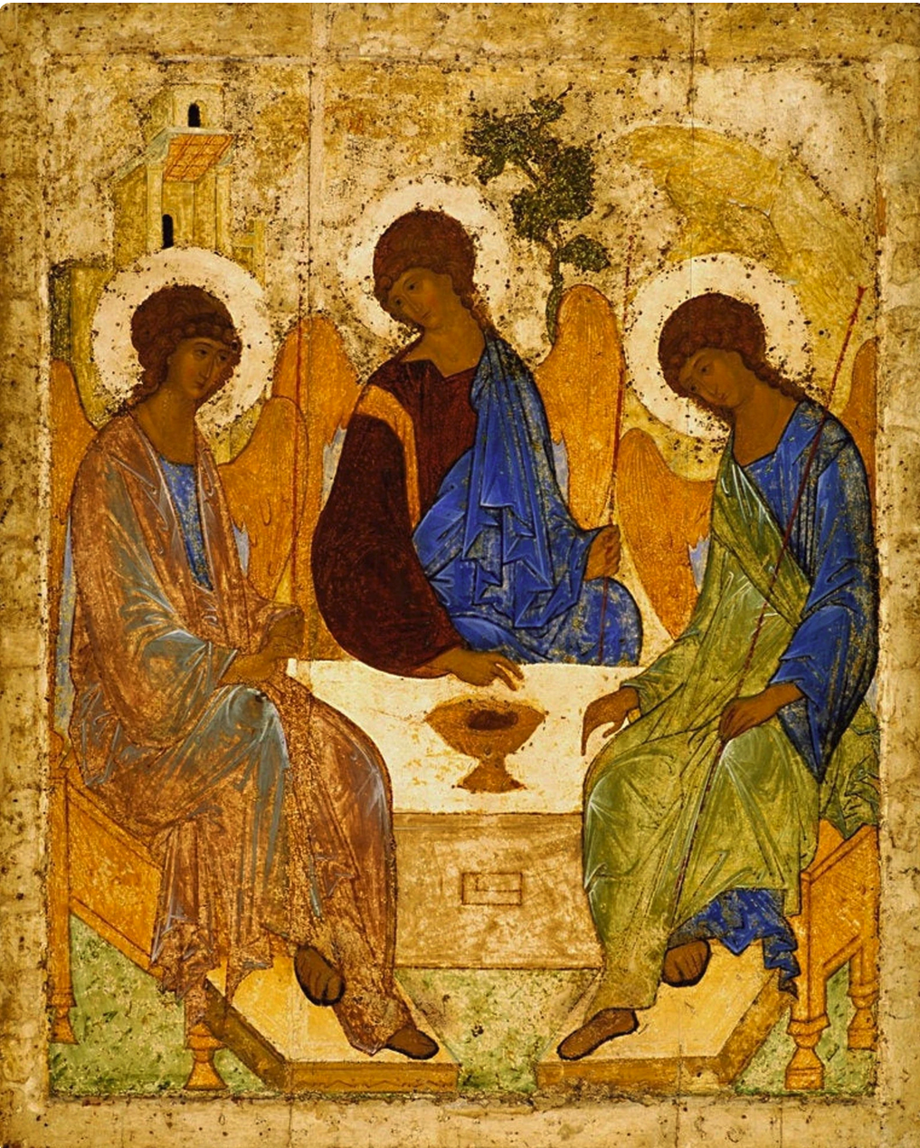

In the beginning…
Strategic planning process
Focused on relationship building
Name of ACC
Logo
Notes:
Michelle F.

Slide 5
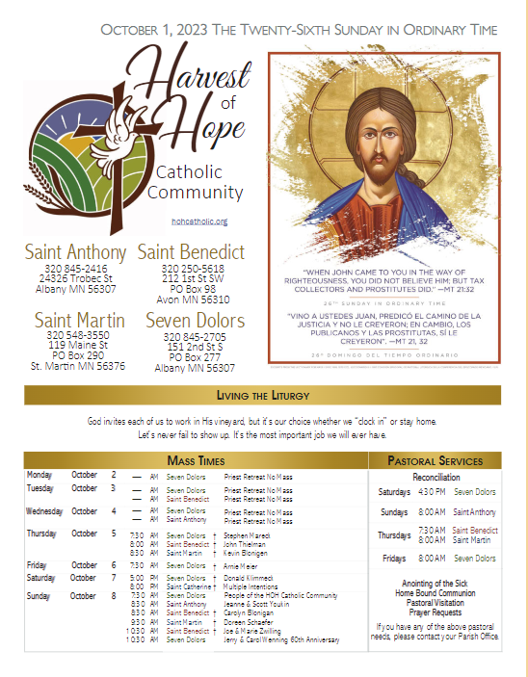
The Bulletin
Initial conflicts:
Issues of identity, finances,
communication
Current process:
Information funnelled to editor
Sent to large group for proofing
“A small miracle every week.”
- Fr. Edward
Notes:
MIchelle - history Dianne on making it work now
Conflict that was under the surface burst open on this issue. But it gave us an opportunity to work together

Slide 6
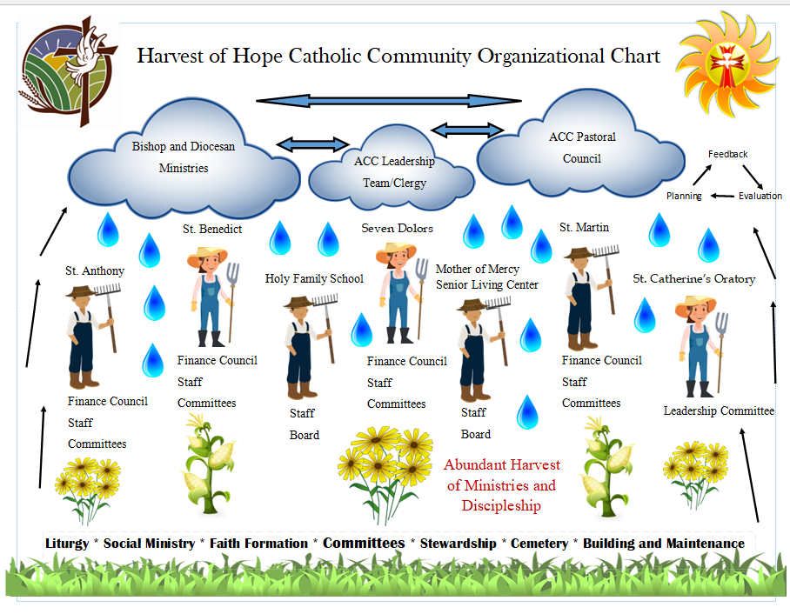
Leadership Structure
Each community has their own staff and volunteers
Common staff positions within the community
Challenges - energy devoted to pastoral care with multiple parishes
Joint staff meetings/yearly retreat
Notes:
Fr. Edward NEED ORG CHART

Slide 7
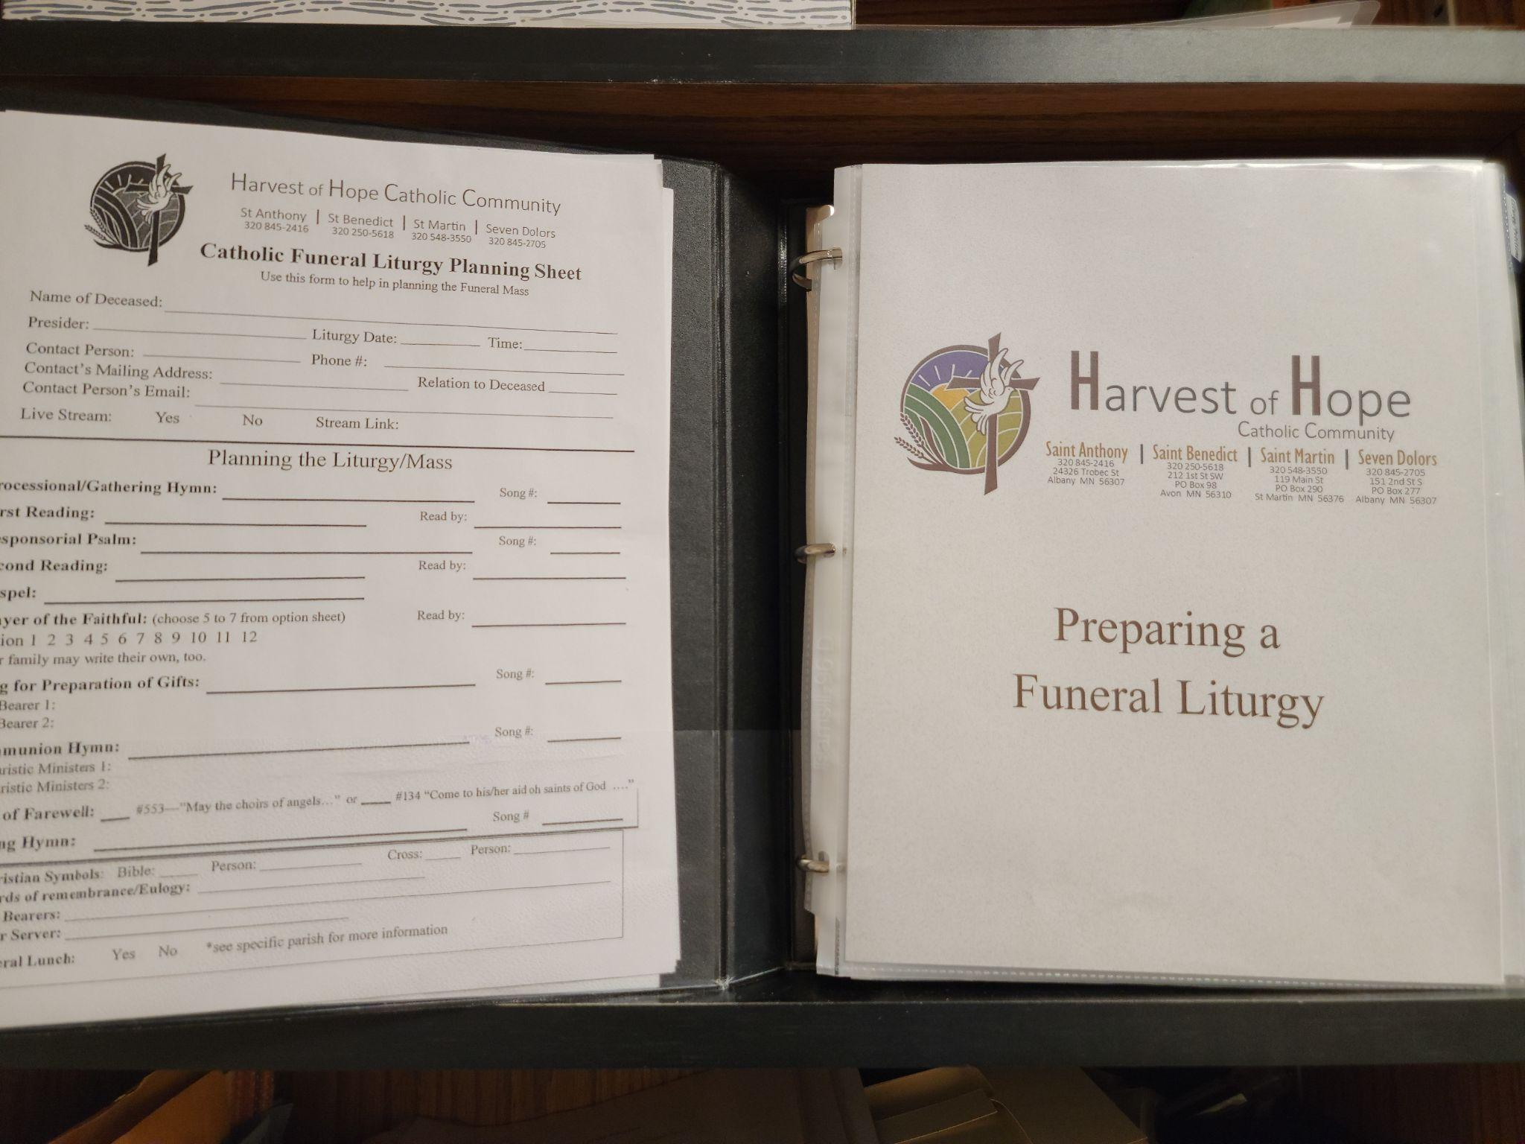

Early Wins
Early Success - Rural Life Celebration
Separate but unified Faith Formation programs: this year share a common theme
Common Confirmation Standards
Sacramental Preparation (Baptism, Weddings)
Shared funeral resources
Notes:
Mary R. (Rural Life) and Toni

Slide 8
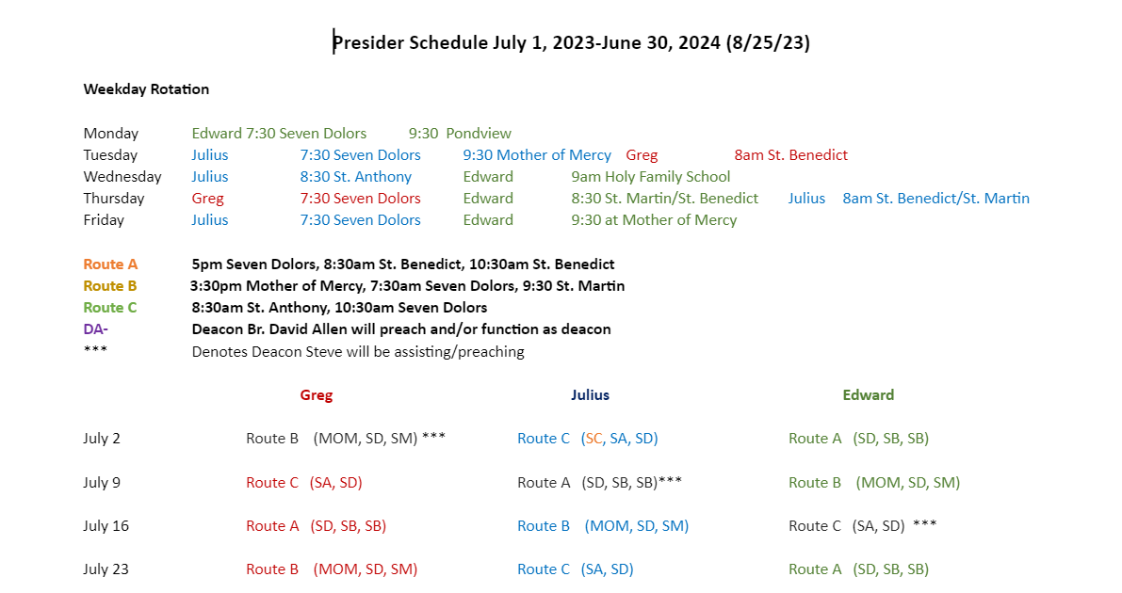
Communication, Communication, Communication
Bulletin
Staff meeting
Website
Presider Schedule
Shared Liturgical Calendar
Social media
Pastoral Council
Notes:
Bring bulletin samples, calendar sample (a page from each) Include our website and facebook names where they can find more information. Abbey

Slide 9

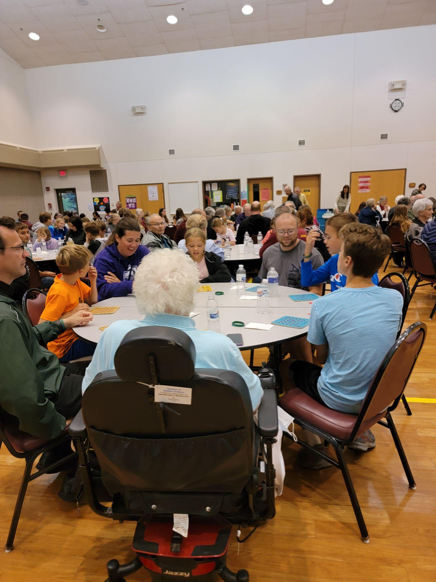
Ongoing collaboration
Holy Family School
122 Students (Preschool-5th grade)
Support from all ACC parishes financially
Parishioners attend and support events, fundraisers
School Mass at Seven Dolors
Clergy classroom visits
Catholic Schools Week
Listening - Survey
Multiple methods of distribution (email, churches, mailed paper copies)
Focus on bringing people together, building relationships
Leadership responded based on results (272 responses)
Bingo
Rotating location between each parish in the ACC
Successful events: 150-200 attendees each time from all parishes
No cost to the parishes, thanks to the Bridge Builder grant
Evening includes a free meal, cash prizes, and HoH logo prizes
Notes:
Sue - Catholic Schools Week/HFS
Nick - Survey and Bingo

Slide 10
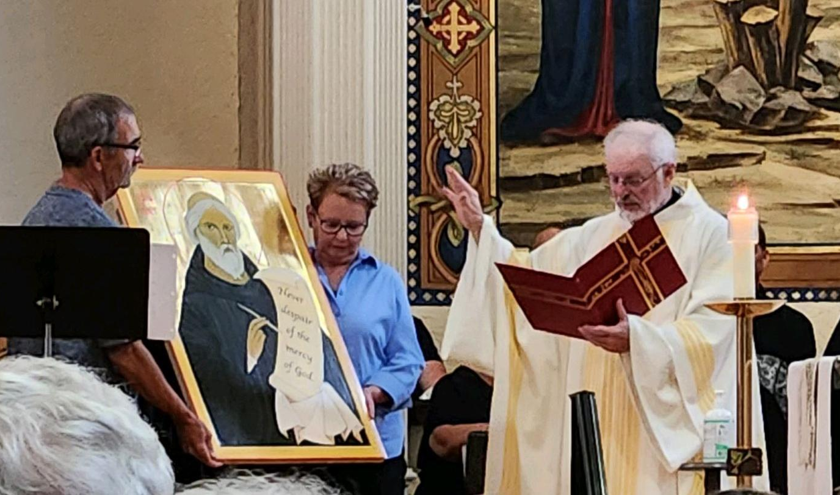
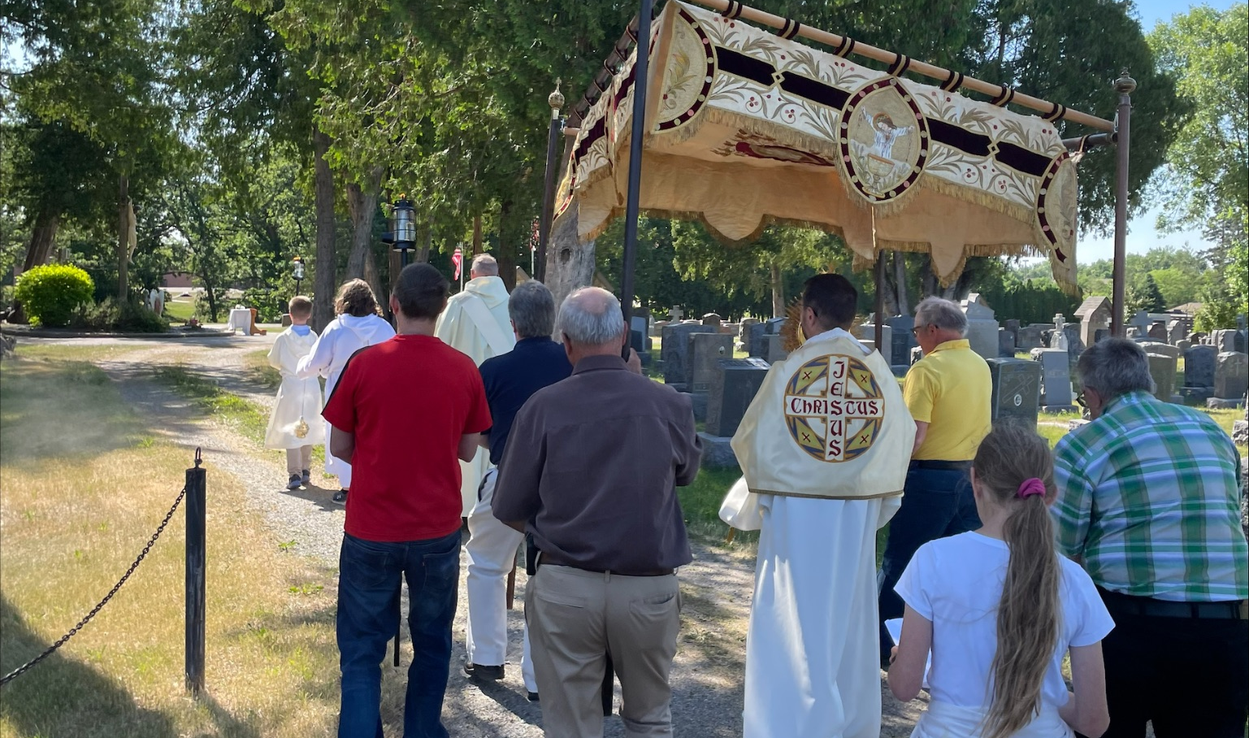
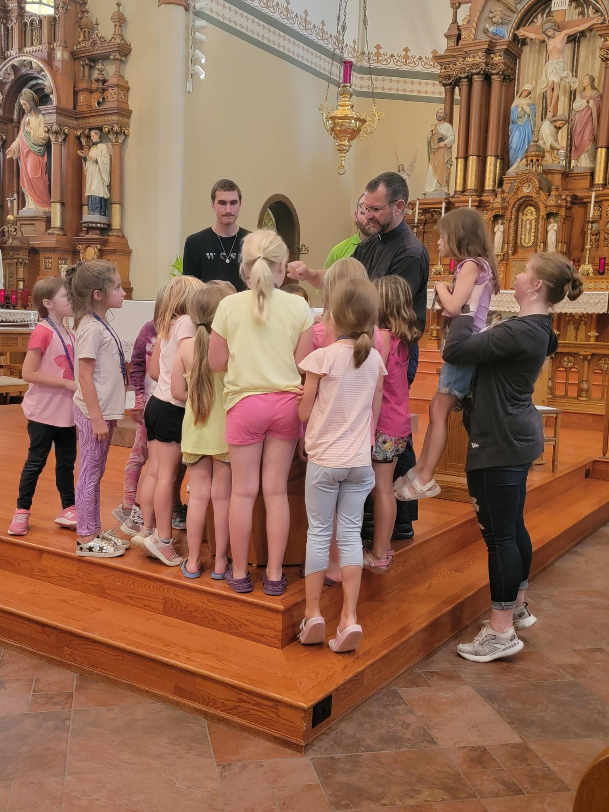
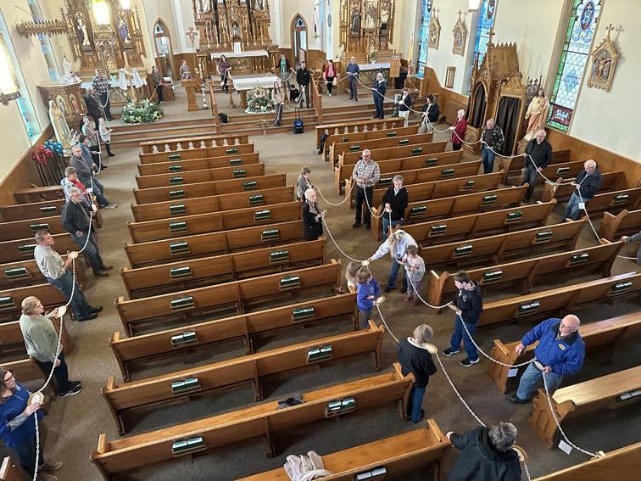
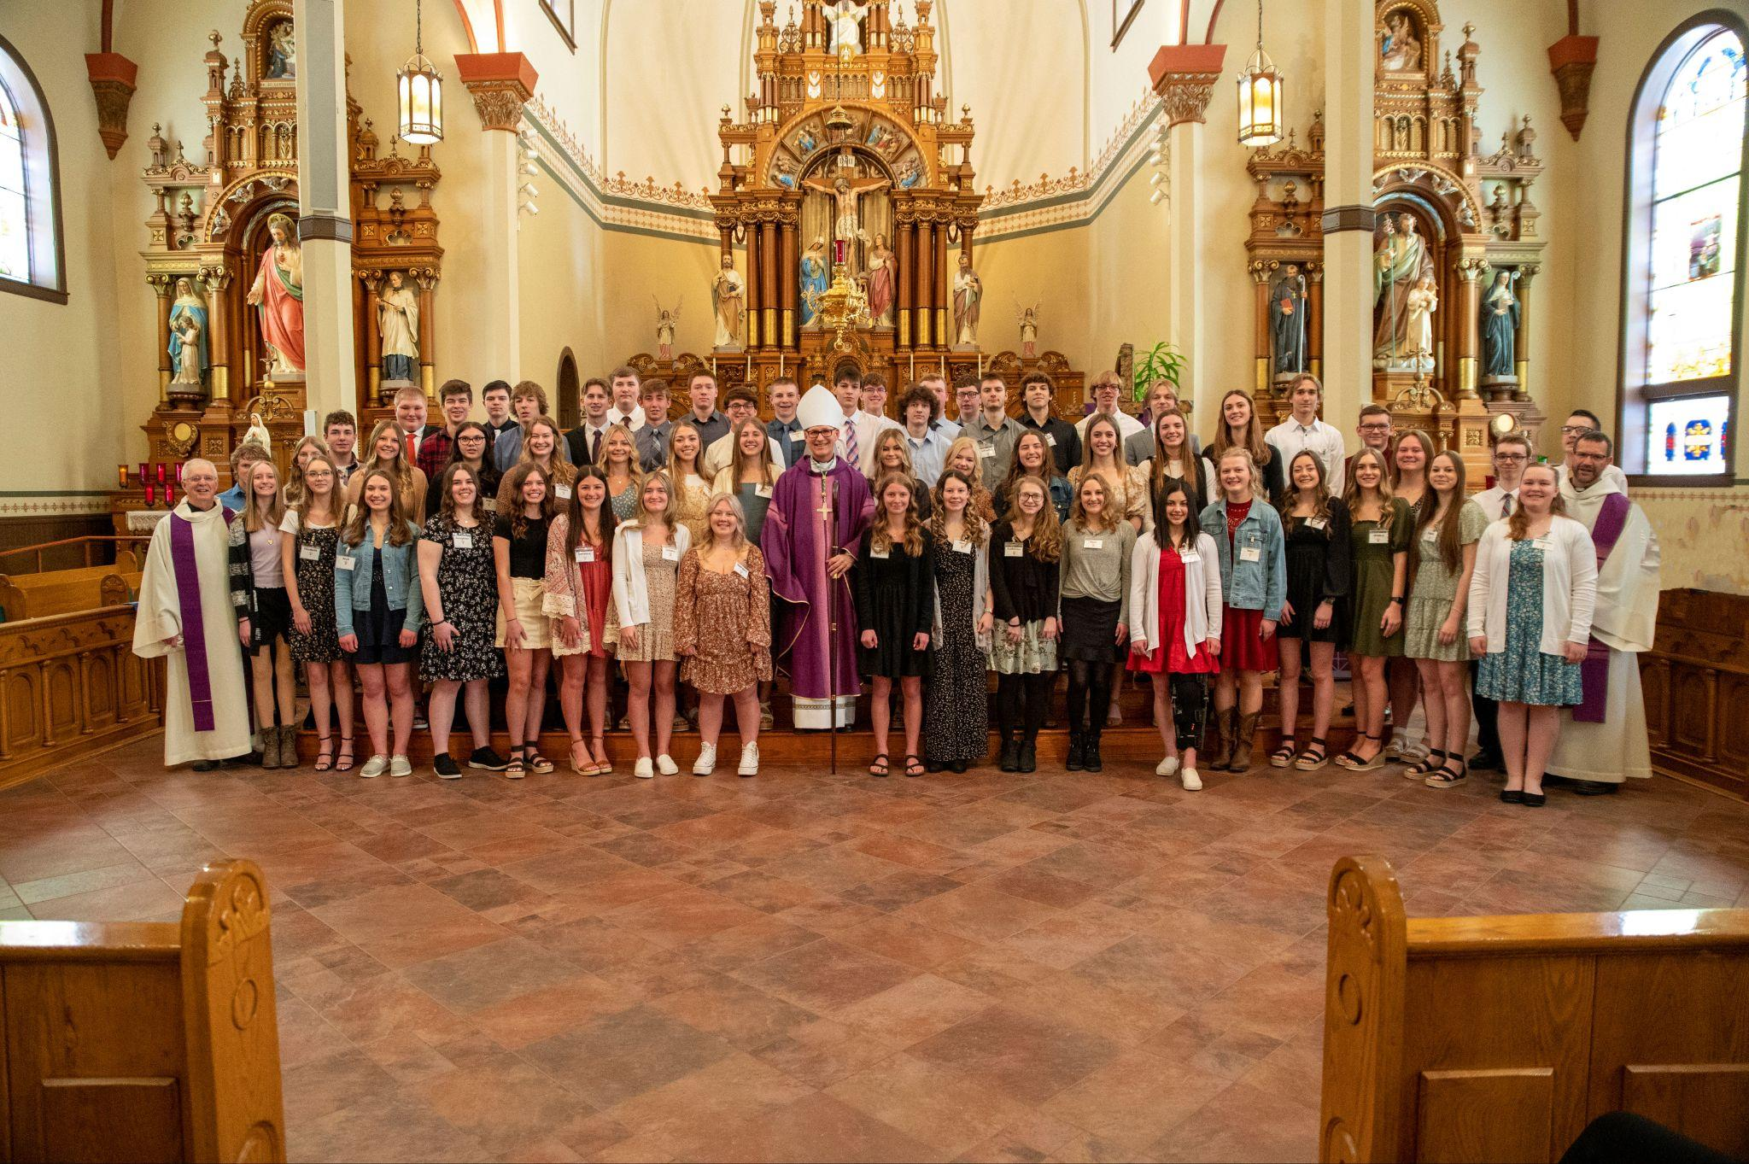
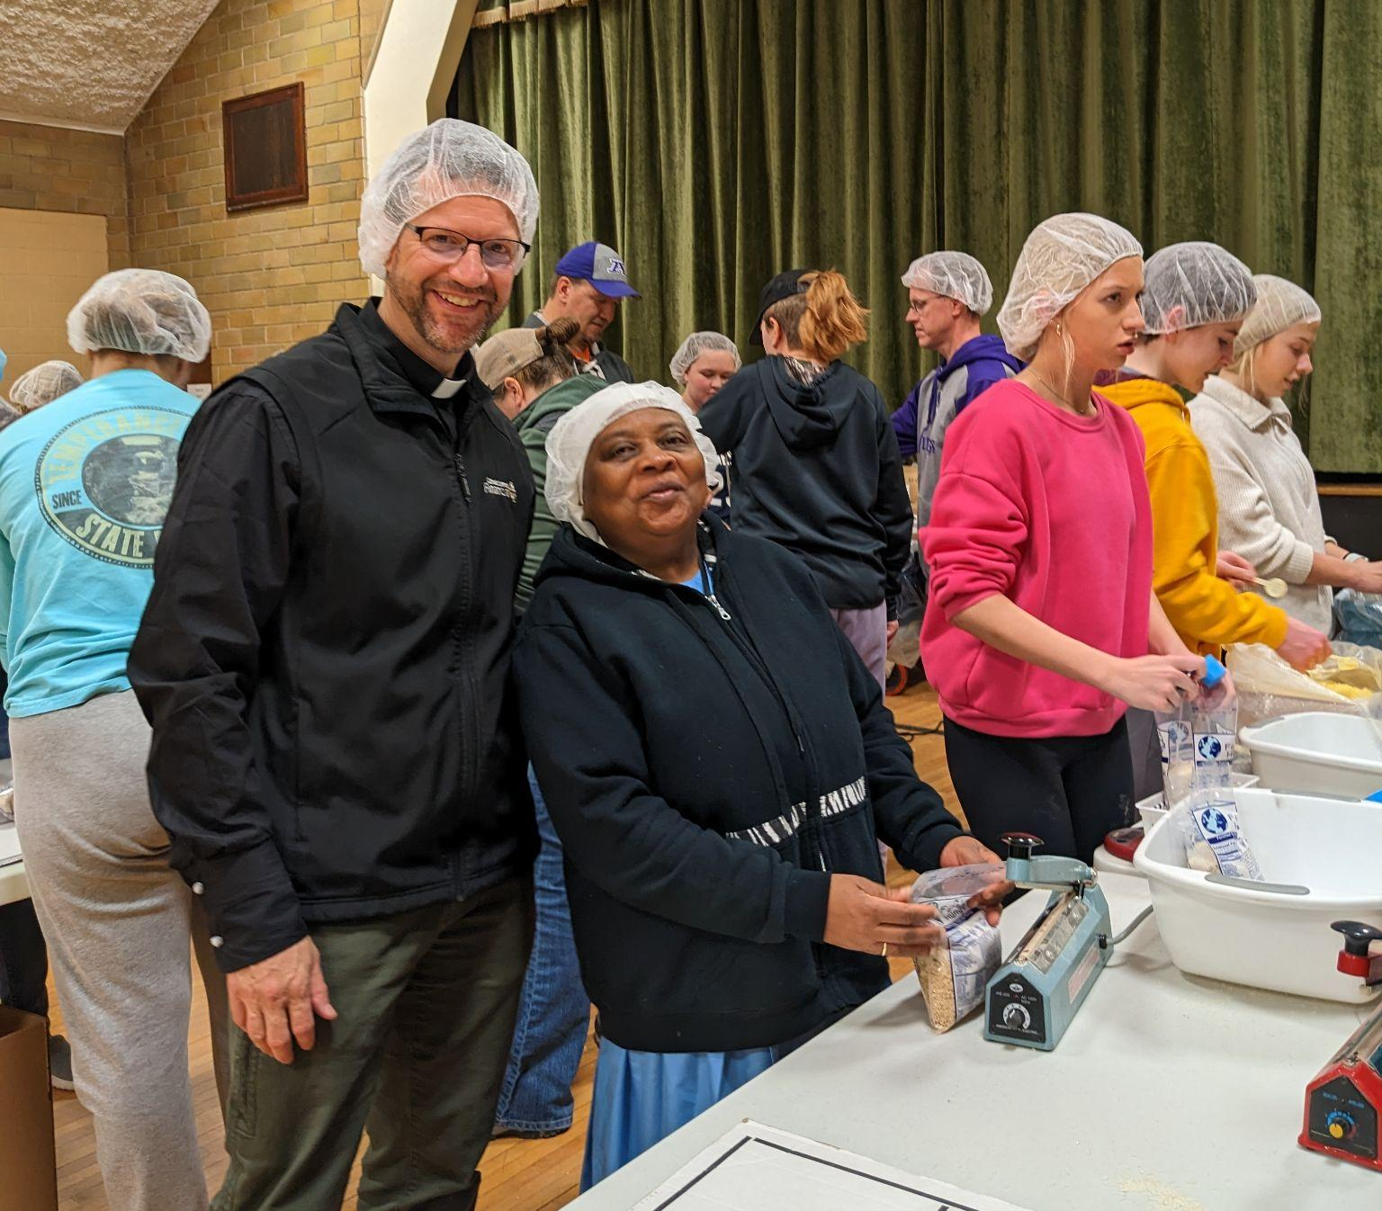
Fruitful Events – Successful Collaboration
Father Greg’s 50th Jubilee
Corpus Christi
Totus Tuus
Living Rosary
Confirmation
Kids Fighting Hunger
Notes:
Abbey - Fr Greg’s celebration Through Team Work, while building new relationships
Karen P - Kids FIghting Hunger - annual event - pack 21,000-25,000 meals each year. Volunteers from all parishes and the school NHS. Supported by the St. Martin Commercial Club and Lions, Farming Lions, Mission Society and parishioners. Approximately 115 volunteers over two hours.

Slide 11
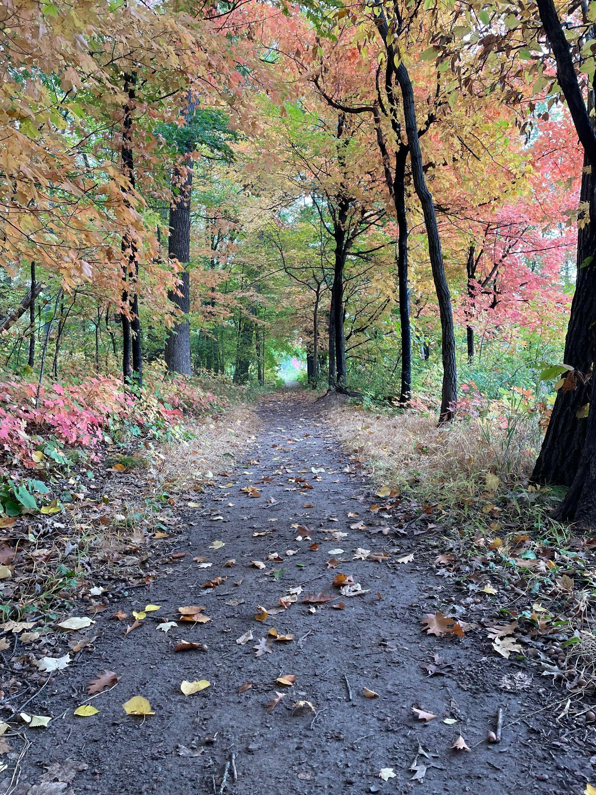
Moving forward…
Mission Statement
Employee Manual (in development)
Outreach: Post-Covid challenges
Synodal survey of parishioners and community
Update strategic plan based on survey answers
Latino ministry
Sync with diocese
  Finance
  handbook
Notes:
FR. EDWARD…

