Slide 1
WOHVn in Faith
Area Catholic Community

Slide 2
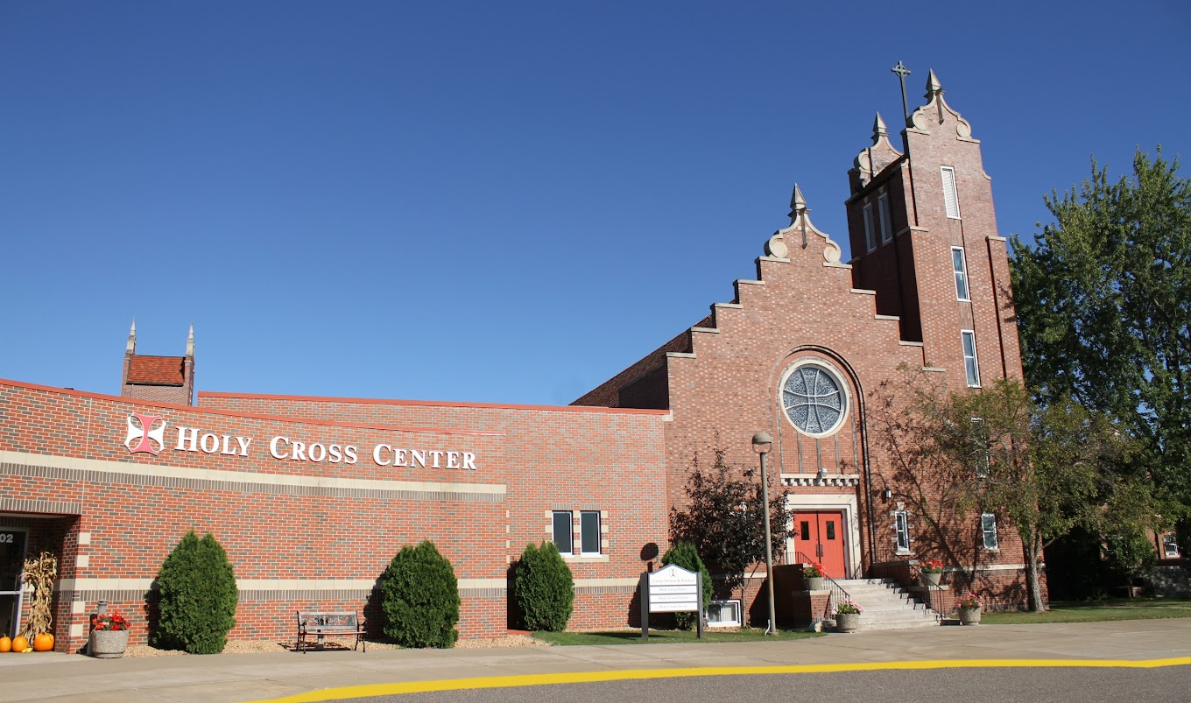
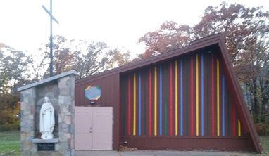
Wahkon
WOHVn
in Faith
The letters that form our Area Catholic Community name are drawn from the first letter of each town where our four parishes reside.
Onamia
Hillman
Vinland

Slide 3
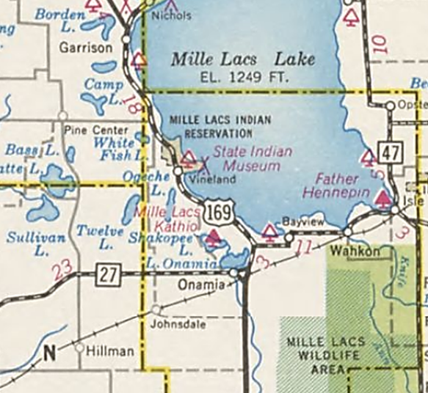
We are located in the northeast corner of the St. Cloud Diocese.
We became the South Mille Lacs Catholic Community cluster in 2004.
We became the WOHVn in Faith ACC in 2019.

Slide 4
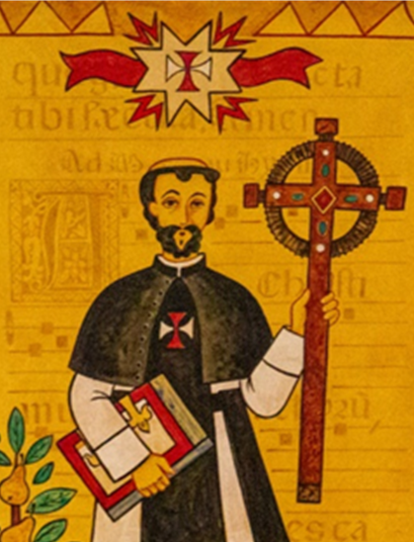
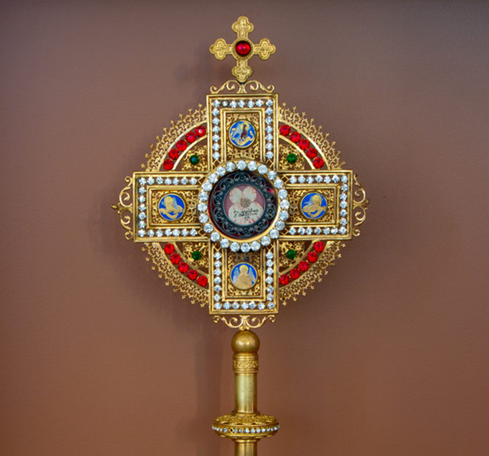
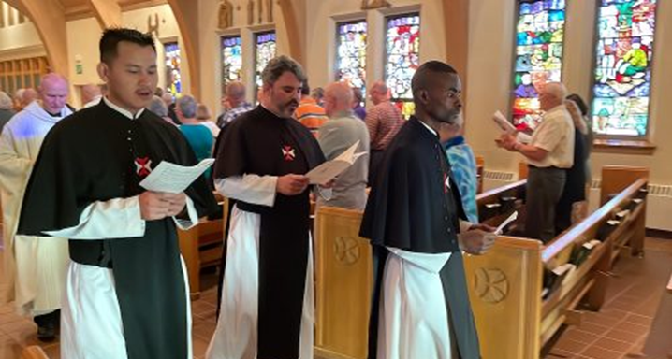
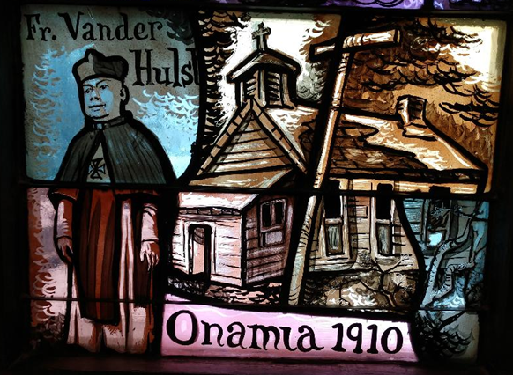
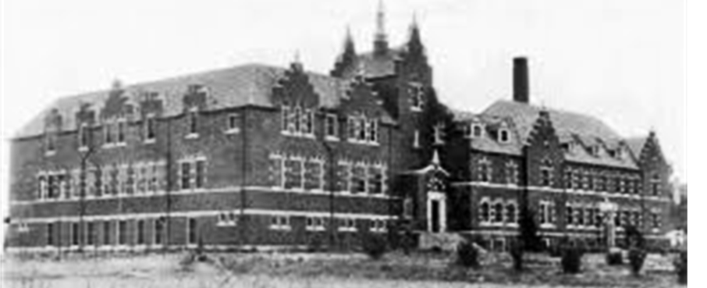
In 1210 the Crosier Order was founded by Theodore de Celles.
In 1910 the Crosiers came to Minnesota.
In 1922 a priory and school were built in Onamia.
The Crosiers serve four WOHVn parishes now and plan to continue into the future.

Slide 5
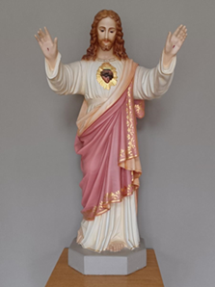
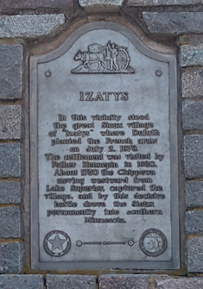
Wahkon – Sacred Heart
WOHVn

Slide 6
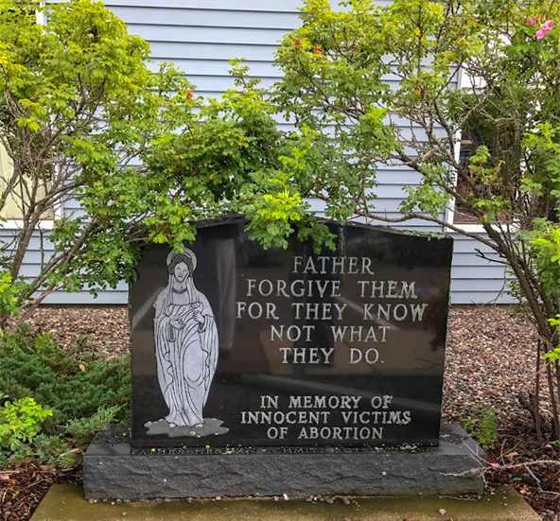
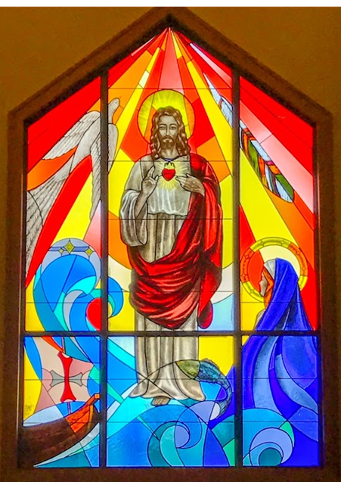
Sacred Heart Parish in Wahkon
1600 – Father Louis Hennepin visits the area
1911 – First parish established
1912 – The Ladies Society is formed
1995 – The current church is completed
2004 – The stained-glass window is installed
Today, Sacred Heart…
serves seasonal homeowners, tourists, and permanent residents
has an active Knights of Columbus
and a youth education program
hosts many events and an annual bazaar
Baptized Catholics– 282
Total Households – 79
ACC Pastoral Council Members – Jon Bjornstad & Mary Bannick

Slide 7
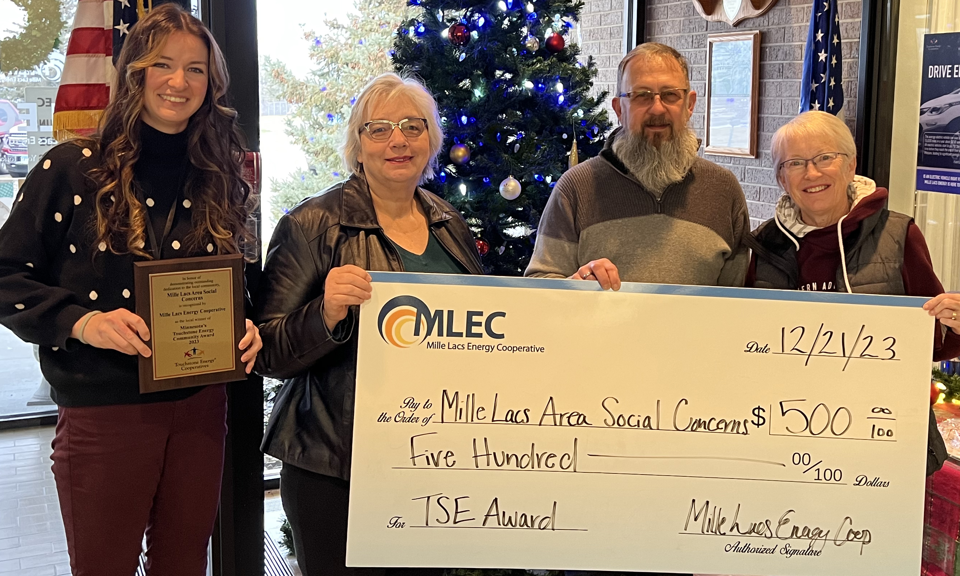
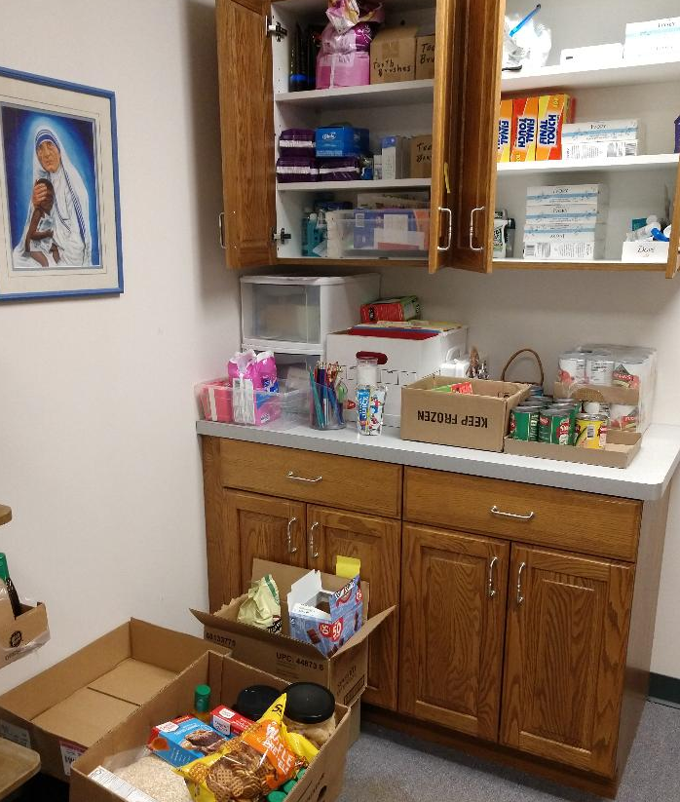
Mille Lacs Area Social Concerns
FREE Thanksgiving meal in 2023:
85 guests served at the dining center
115 meals delivered

Slide 8
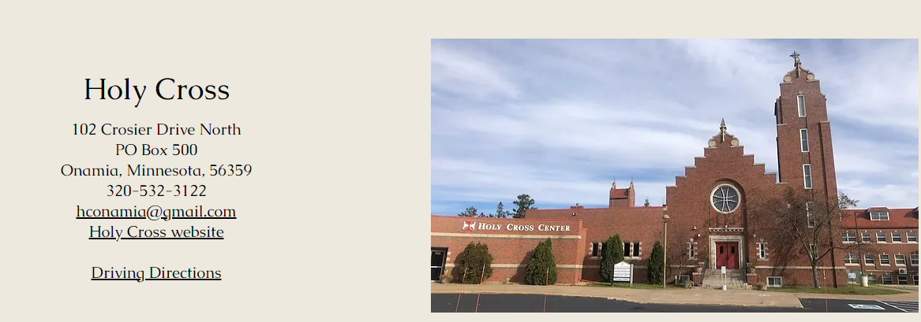
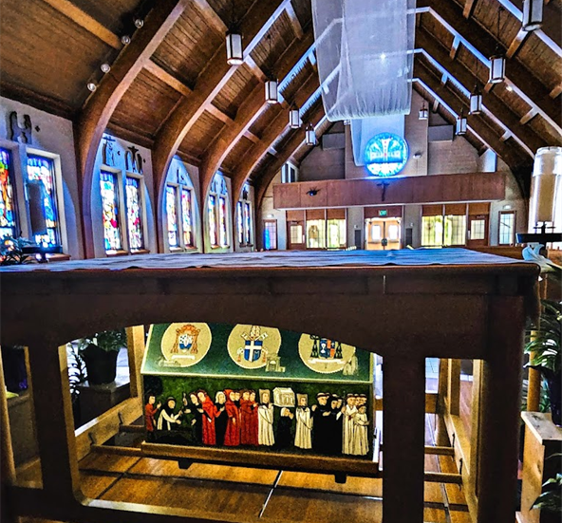
Onamia – Holy Cross
WOHVn

Slide 9
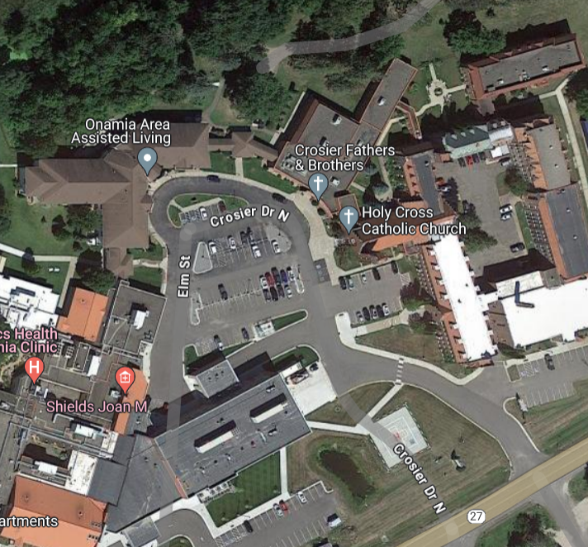
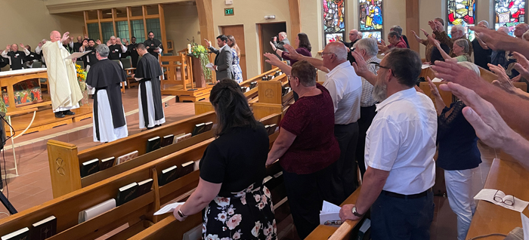
Holy Cross Parish
in Onamia
BUILDINGS:
Holy Cross Priory Church with the St. Odilia Shrine
Holy Cross Center: offices, storage, classrooms, dining hall, and kitchen
EVENTS:
Shared Sunday Mass with the Crosier Community
Lenten Fish Fries
Autumn festival
Active Parish Life Committee
Baptized Catholics – 180
Total Households – 129
ACC Pastoral Council Member – Steve Timmers

Slide 10
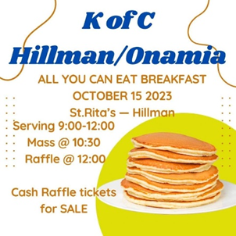
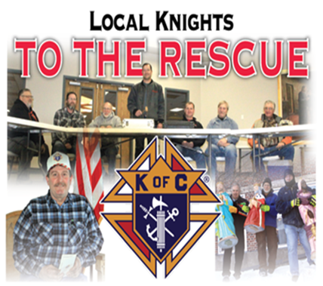
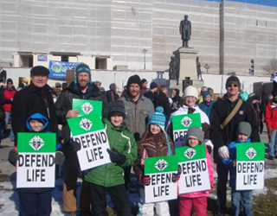
Knights of Columbus
Serve our Pastor and the Diocese of St. Cloud
Support local parishes
Fr. Hennepin Council - Sacred Heart
St. Joseph’s Council – Holy Cross and St. Rita’s

Slide 11
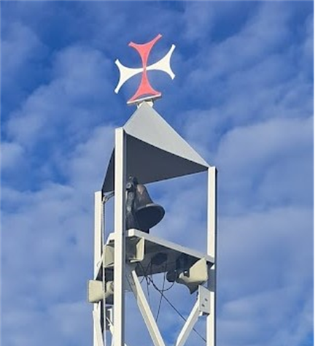
Hillman – St. Rita’s
WOHVn

Slide 12
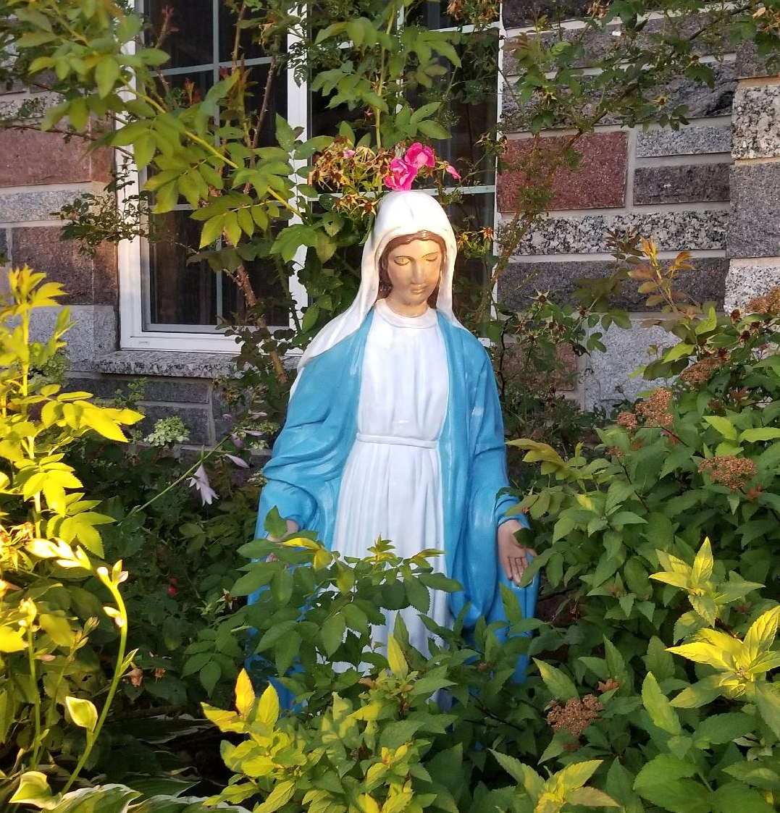
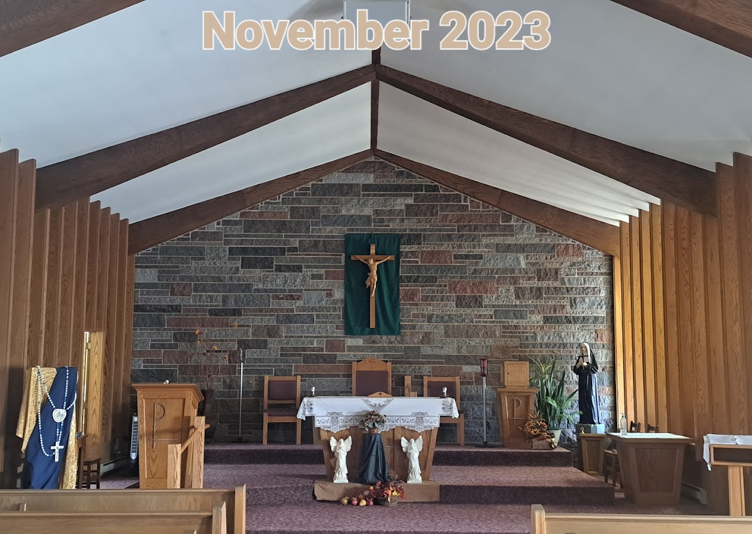
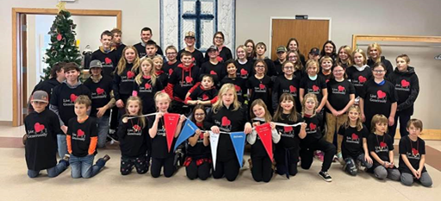
St. Rita’s
in Hillman
We are…
Served by the Crosiers since 1937
A rural community spanning 4 school districts and surrounded by family farms and forestland
An active, growing parish
Very busy hosting multiple fundraisers, youth activities, and social events, including a quilt bingo and Prime Rib dinner
Baptized Catholics – 437
Total Households – 180
ACC Pastoral Council Members – Amanda Gjerde and Calvin Beumer

Slide 13
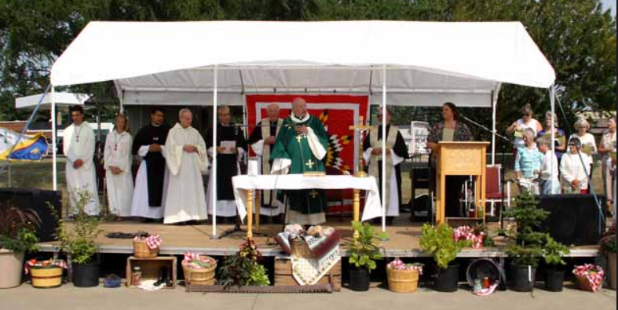
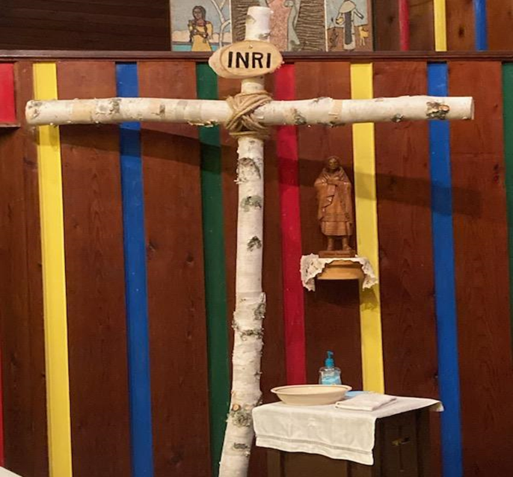
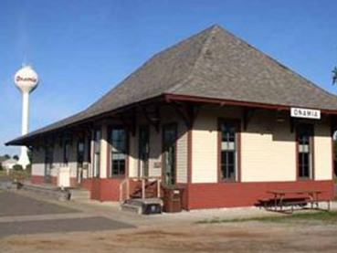
Rural Life Celebration and Mass August 18, 2013

Slide 14
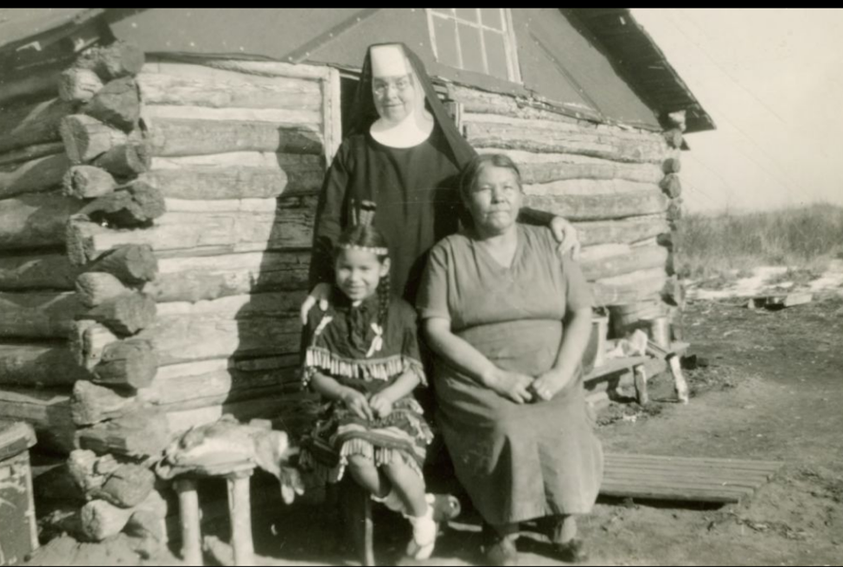
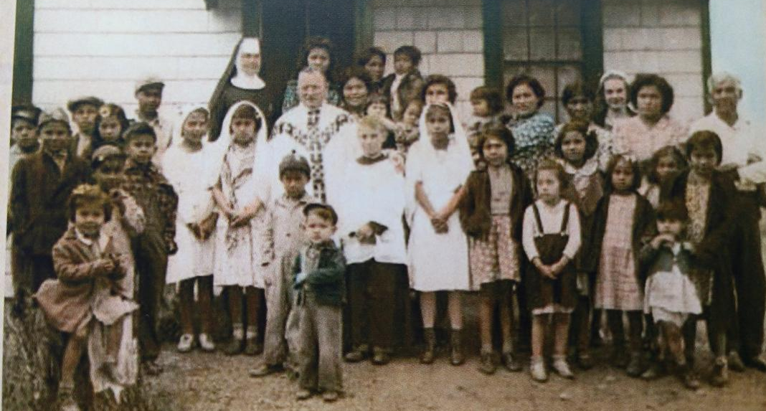
Vineland – St. Therese
WOHVn

Slide 15
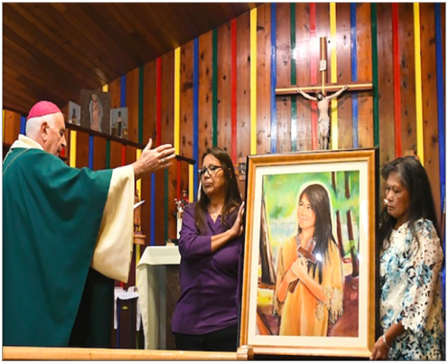
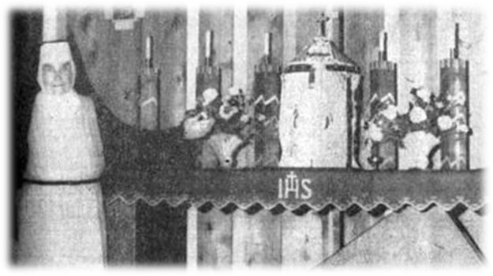
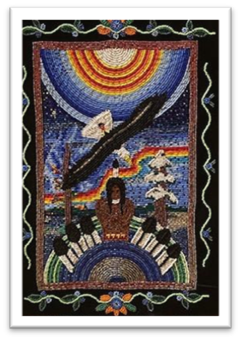
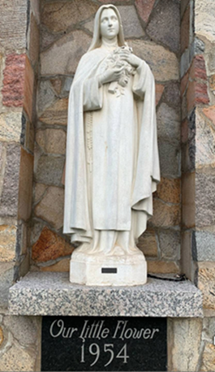
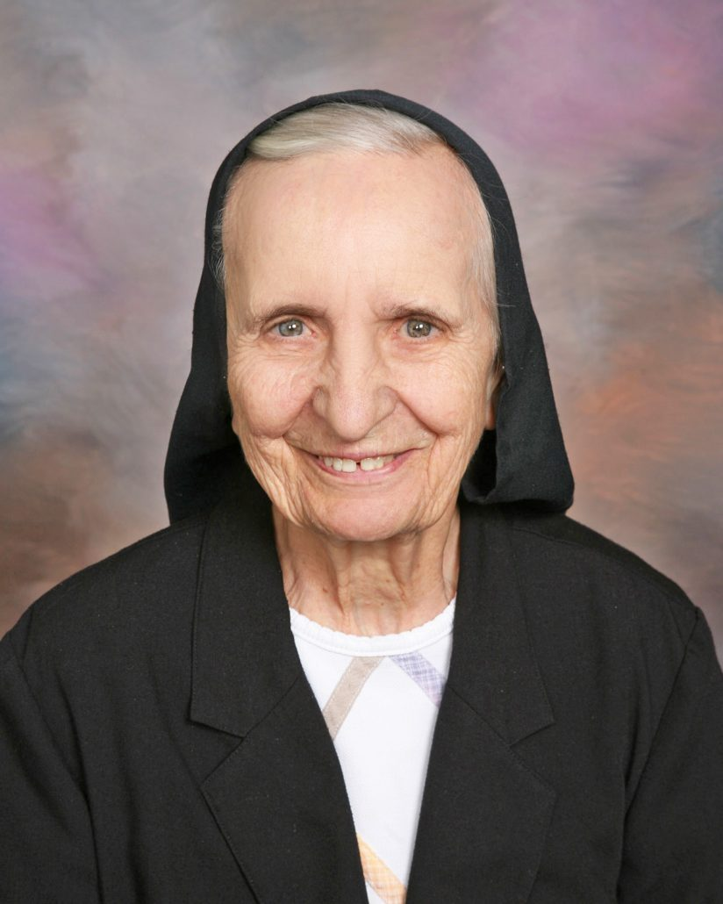
St. Therese Little Flower
Mission Chapel
Vineland Bay
The present church reflects the Ojibwe culture in its design and interior decorations.
Many tourists are welcomed here each year.
It is a simple building in a rustic surrounding for all to worship God.
St. Therese Parish has the fewest registered members in the St. Cloud Diocese.
This is a mission church on the Mille Lacs Indian Reservation, the only one in the Diocese.
Baptized Catholics – 49
Total Households – 17
ACC Pastoral Council Member – Margaret Willis
Sr. Laura Hesch, OSB, stands next to the Little Therese Tabernacle made from birch bark and deer skin.
Sr. Mary George Ortmann, OSB

Slide 16
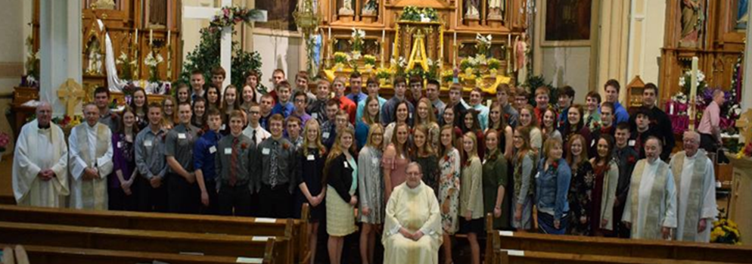
Who are we as an ACC?
We share…
the Crosiers
cluster status since 2004
two active Knights of Columbus councils
lots of dedicated volunteers
tourism, seasonal membership, and rural surroundings
confirmation classes for 20+ years
two parish secretaries
one Business Manager
Confirmation with Pierz
and Little Falls, 2018

Slide 17
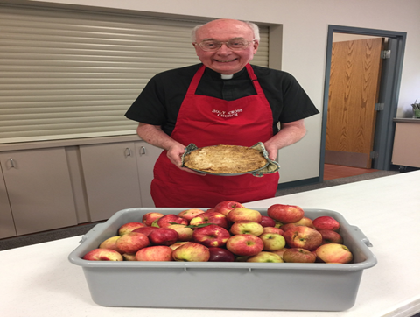
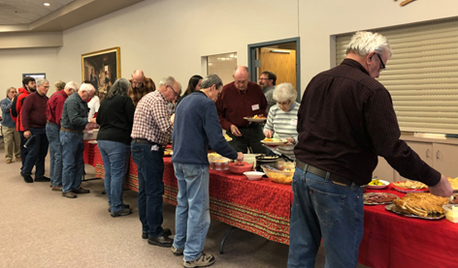
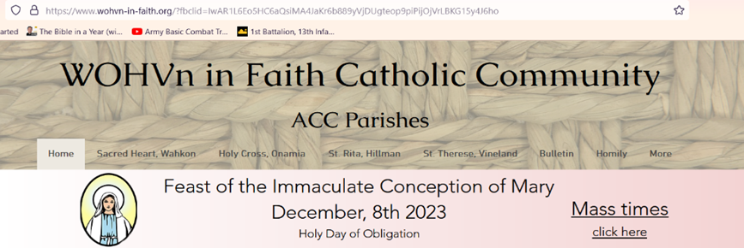
Strengths
Mutual respect among our members - we feel supported and heard
Holy Cross Center is a centrally located space
A weekly shared bulletin & website (wohvn-in-faith.org)
The Crosiers and Fr. Jerry

Slide 18
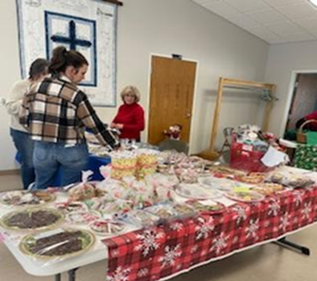
Listening to the People
ALL parishes were involved in the preparation for this presentation.
Parish Life committees will help our ACC council succeed.
Time and talent information is being gathered.
Casual, post-Mass socials are encouraging conversation.
Input is still being sought out from each parish.

Slide 19
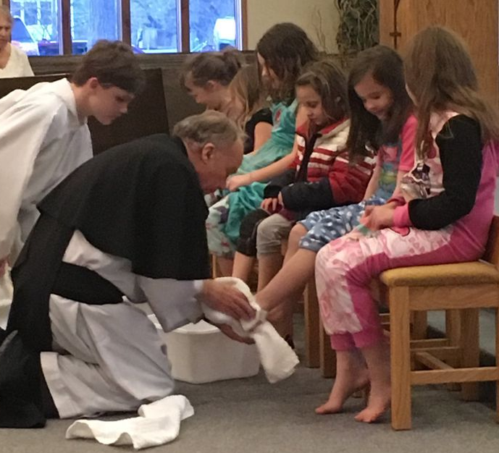
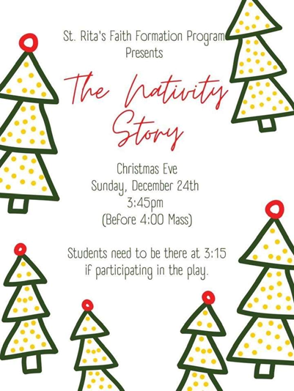
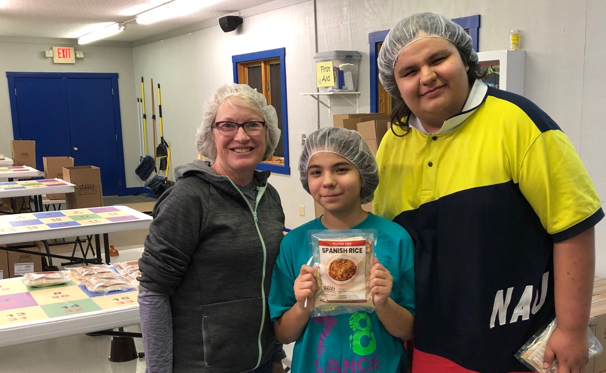
Formation of Leaders
Youth Faith Formation
Confirmation
Knights of Columbus
Media Kiosks and libraries

Slide 20
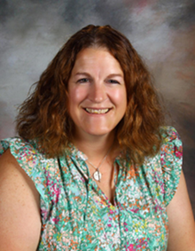
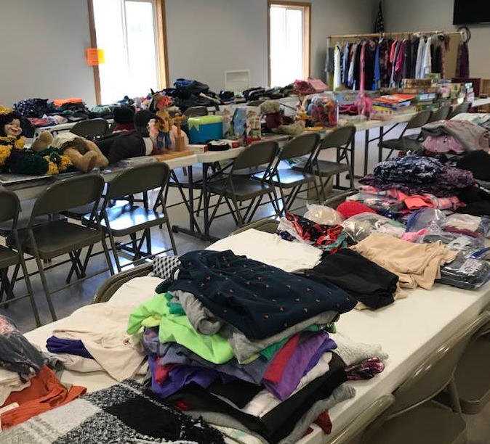
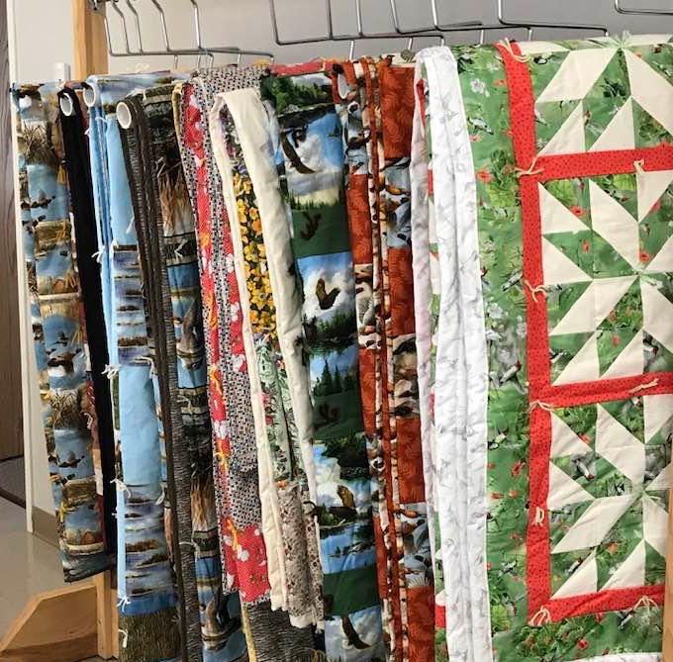
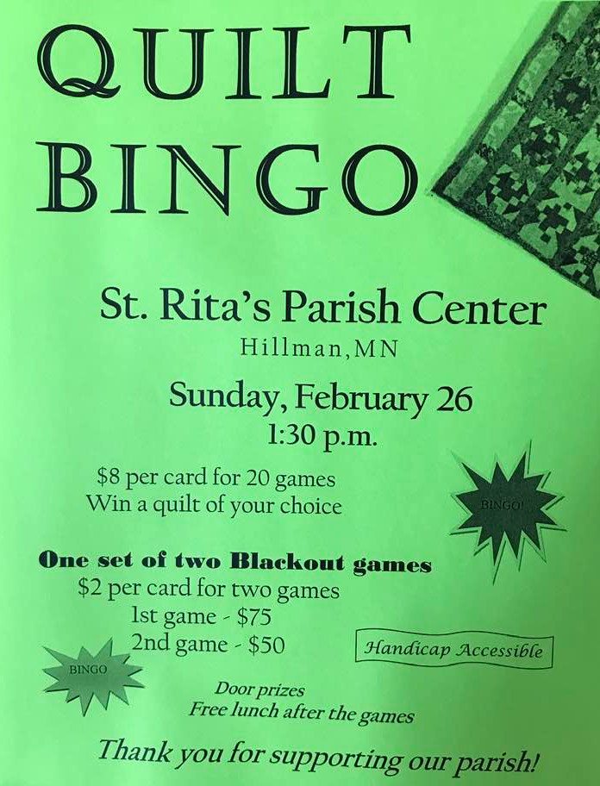
Challenges…
Our new Business Administrator, Amanda Gjerde, will begin full-time work in June 2024.
We currently do not have a designated ACC council leader.
Physical distance is a limiting factor.
Some parishioners are not comfortable with new people and the idea of a Faith Community.
Stagnant membership is a problem.
Only a few parishioners are doing most of the work.
We must rely on fundraising to pay the bills.

Slide 21
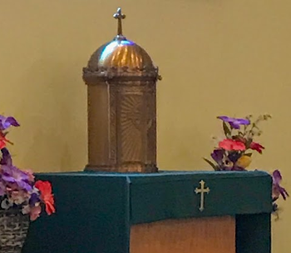
Nurturing Eucharistic Spirituality
The Extraordinary Minister information session was well attended.
Catholic materials are available at most of our parishes.
Some Extraordinary Ministers are assigned while others volunteer when needed.

Slide 22
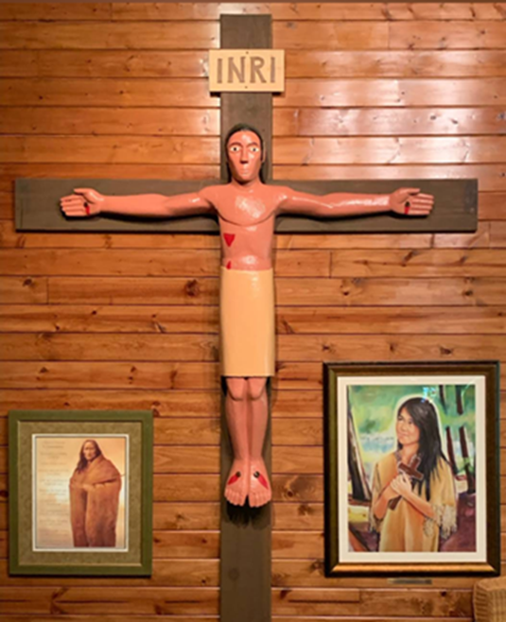
Priorities
Pool our resources, work together, and cross borders to become a stronger ACC.
Share our faith journey through mission groups.
Become active in the Deanery of Christian Women.
Create an ACC roster and photo directory.
Work with our ACC Business Administrator to build community.
Help the Diocese maintain a Catholic presence on the Mille Lacs Reservation by helping the St. Therese parish to flourish.

Slide 23
We are… WOHVn in Faith
January 2024

